Slide 1
Data Visual Design & Storytelling
Day 3

Slide 2
Visual design theory
Common mistakes
Misleading statistics and visual distortions
How do our brains interpret and organize visual information?
How do you create charts that are easy for your audience to read?
Notes:
The purpose of this slide is to indicate the start of the section.

Slide 3

Visual design theory
Our eyes “load” information while the brain “processes” it.
We give the most attention to what looks good and struggle when our working memory is overwhelmed.
For information to be effective, it should not provide more data than what the human brain can process.
Notes:
The purpose of this slide is to introduce the concept of working memory / cognitive load.

Slide 4

Example: buying oranges
You want to buy oranges at a new supermarket.
Our eyes scan the layout of the supermarket, while the brain processes the various sections.
The brain then instructs the eyes to zone in on the fruit section by sending signals about how fruits look from memory.
The eyes then break the entire scanned area into parts and scan each part to spot the fruit section.
The process is repeated until oranges are located.
Notes:
The purpose of this slide is to give a relatable example of how the brain works when trying to figure out visual information.

Slide 5
Designing compelling visuals
Our eyes and brains work the same way with data visualizations as they did in the oranges example.
Use visual clues to make data visualizations easier for the audience.
However, every piece of information in a visualization also creates cognitive load on the viewer, asking them to use their brain power to process it.
Reduce visual clutter to lower the cognitive load and help transmission of the message.
Notes:
The purpose of this slide is to introduce the idea that visual clues and clutter-free visuals help the brain to “get” a visualization.
Note that reducing visual clutter was covered the previous day.

Slide 6
Sources of visual design theory
The visual design tips we’ll review today draw on theory such as:
the building blocks of visual design described by the Interaction Design Foundation
the four categories of preattentive visual attributes described in Colin Ware’s book, Information Visualization: Perception for Design
See page 35 of the participant guide for a list of additional resources
the Gestalt Principles of visual perception, which describe how people group similar elements, recognize patterns, and simplify complex images when we perceive objects
Notes:
The purpose of this slide is to note that our tips are based in theory.
TELL students that additional resources can be found in their participant guide.

Slide 7
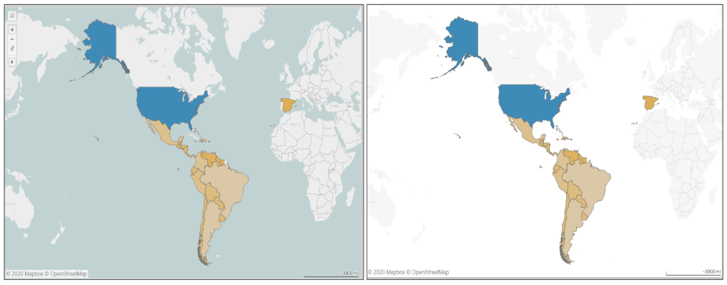
Choose a contrasting background
Tip 1
People instinctively perceive objects as either being in the foreground (important) or the background (less important).
Therefore, ensure that there is enough contrast between the figure and background to reduce cognitive load and increase readability.
Notes:
The purpose of this slide is to describe the theory behind the tip and how it can be enacted.
In the above images, making the background much lighter and washing out other countries makes the viewer not focus on the oceans and other countries in background

Slide 8
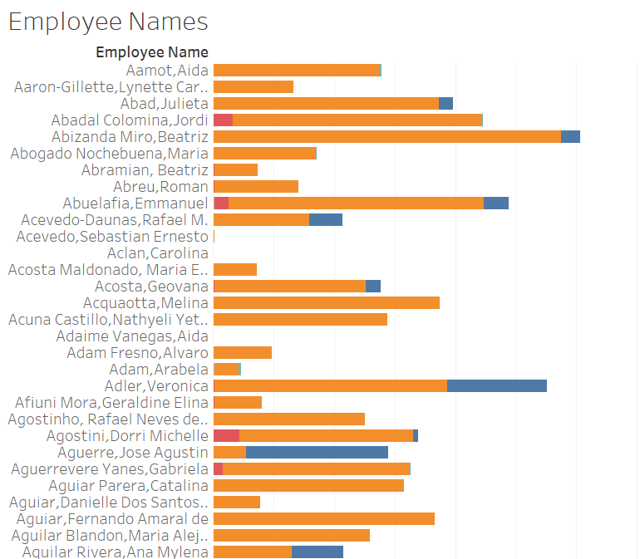
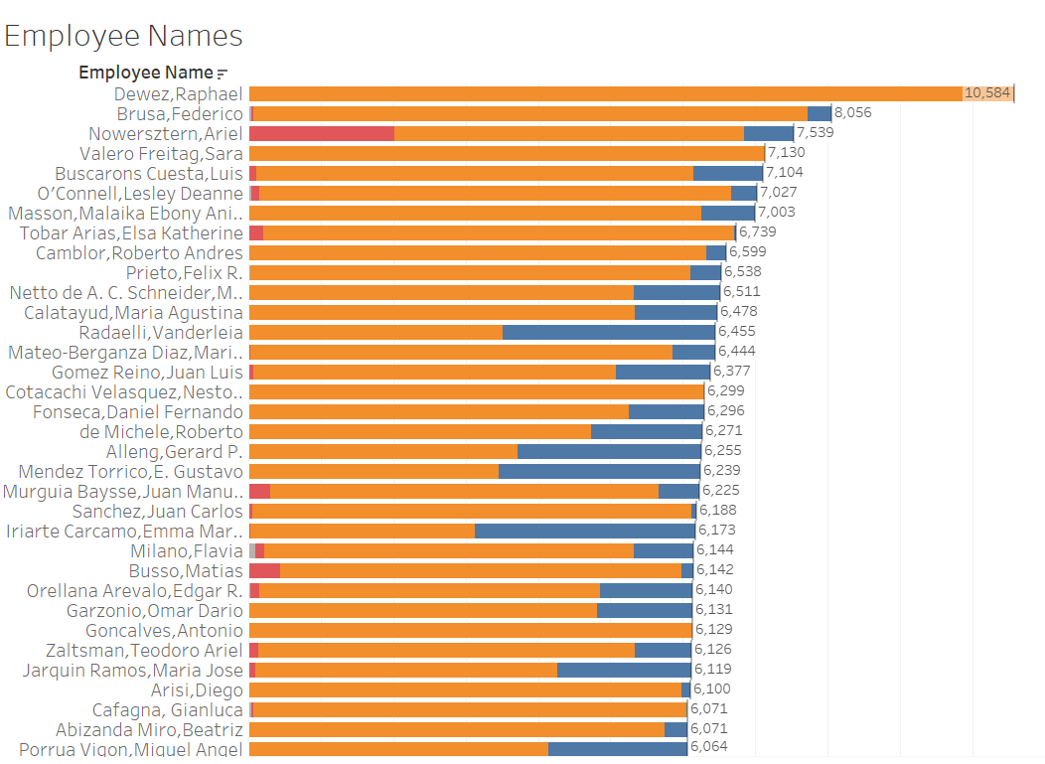
Make position meaningful
Tip 2
Data should be sorted and placed in the visual in a meaningful way.
A
Z
How are these charts sorted? When and why would you use one over the other?
Notes:
The purpose of this slide is to describe the theory behind the tip and how it can be enacted.
ASK students to think about when one chart might be better than the other. ANSWER: if employees need to find their names go A-Z; if management is making decisions, go by value

Slide 9
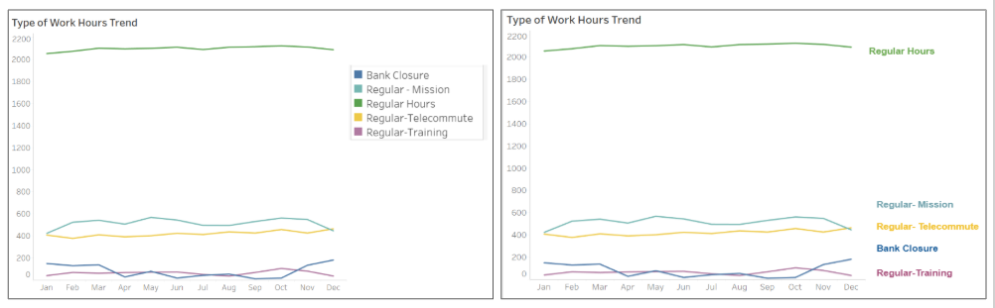
Group related items
Tip 3
Things that are closer appear to be more related than those that are spaced farther apart.
In fact, proximity overrules the similarity of other factors (e.g., shape, color).
Notes:
The purpose of this slide is to describe the theory behind the tip and how it can be enacted.
In the right visualization, by having the type of hour labeled right next to the data they represent we have eliminated the work of going back and forth between the legend and the data.

Slide 10
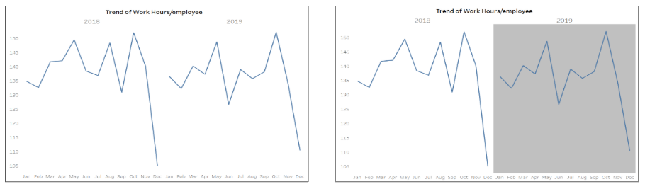
Used closed regions to group
Tip 4
Objects located within the same closed region are perceived as grouped together.
We can use this principle to get the viewer to focus on a group of objects in the chart.
Notes:
The purpose of this slide is to describe the theory behind the tip and how it can be enacted.
In the right image we are enclosing the trend in 2019 in a gray shaded region to show the following months belong to one year.

Slide 11
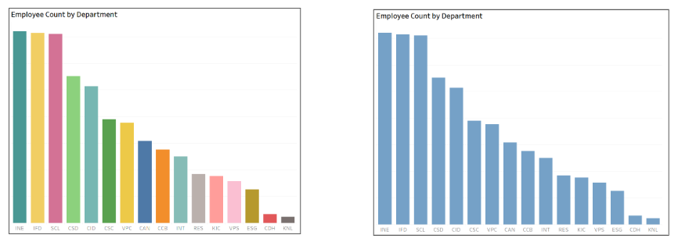
Distinguish different items
Tip 5
The mind groups together things that look to be similar and assumes they have the same function.
We can use this principle for:
distinguishing different sections
differentiating links from regular text
showing that elements with certain characteristics serve one purpose and others different
F
A
B
C
D
E
F
G
H
I
J
K
L
M
N
O
P
A
B
C
D
E
F
G
H
I
J
K
L
M
N
O
P
Notes:
The purpose of this slide is to describe the theory behind the tip and how it can be enacted.
Giving the bars same color makes the departments seem more similar than different, while reducing cognitive load.

Slide 12
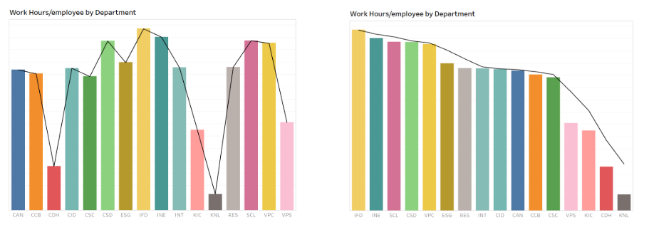
Arrange on a line
Tip 6
Elements arranged on a line or curve are perceived to be more related than elements not on the line or curve.
Notes:
The purpose of this slide is to describe the theory behind the tip and how it can be enacted.
In the right visualization, the eyes follow a continuous downward direction making the whole chart more readable

Slide 13
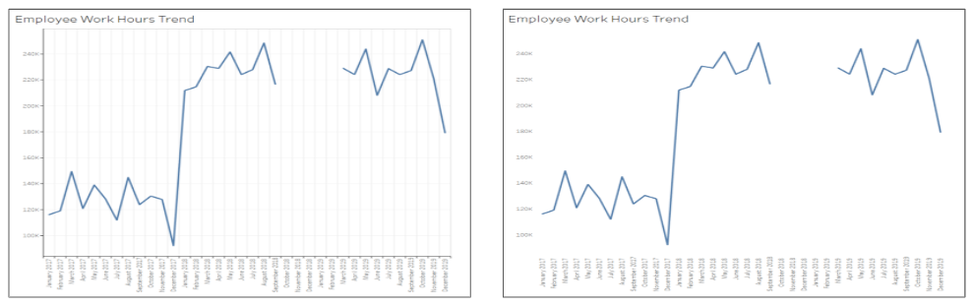
Address data gaps
Tip 7
When parts of a whole are missing, our eyes fill in the gap as we look for a single, recognizable pattern.
Therefore, gaps in data should be addressed.
Notes:
The purpose of this slide is to describe the theory behind the tip and how it can be enacted.
In the right visual, we removed elements like the chart borders and background shading, but our graph still appears as a cohesive entity. Also observe that, when data is missing for few months, our mind automatically imagine a line connecting the 2 broken lines even though in reality it may be different
Optional chat question: How might you address a gap in data?

Slide 14
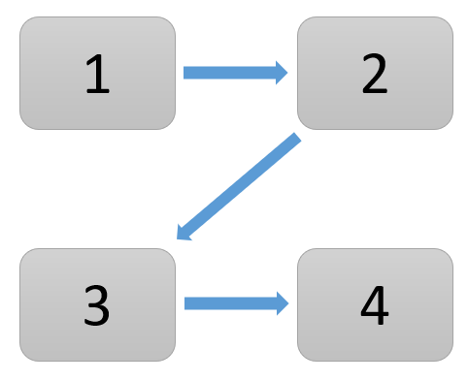
Use natural positioning
Tip 8
People usually tend to start at the top left of the visual and scan in zig-zag motions across the page forming a Z-pattern.
Aim to position elements in a way that will feel natural for users to consume.
Also, remember that the top of the page is the most precious.
Notes:
The purpose of this slide is to describe the theory behind the tip and how it can be enacted.
TELL students that this is true in cultures that read left to right. It may differ in other cultures.

Slide 15
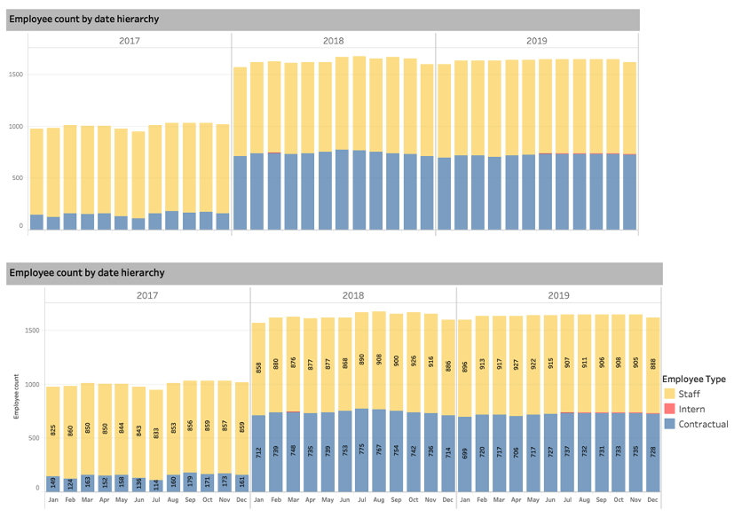
Use labels and legends
Tip 9
Labels can be used to show value of datapoint.
Legends can be used to identify the size, color or any other distinguishing feature in the visual.
The labels and legends used in the bottom chart makes it easier to understand.
Notes:
The purpose of this slide is to describe the theory behind the tip and how it can be enacted.

Slide 16
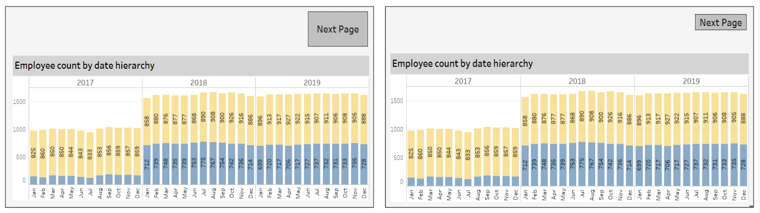
Use size to show importance
Tip 10
Relative size represents relative importance.
Visuals of almost equal importance should be sized similarly.
If there’s one really important thing, it must be BIG.
Resizing the “Next Page” button deemphasizes its importance.
Notes:
The purpose of this slide is to describe the theory behind the tip and how it can be enacted.

Slide 17
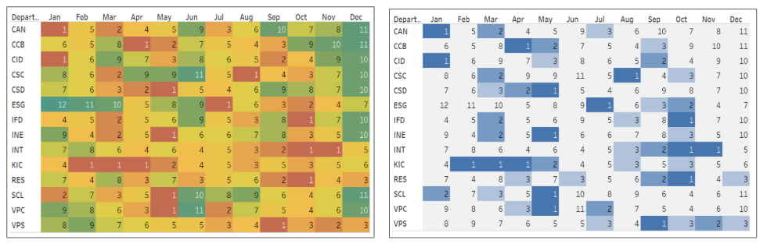
Use color to grab attention
Tip 11
Color is another powerful tool used to draw the audience's attention
However, the following must be kept in mind:
Use it sparingly: too much variety prevents anything from standing out
Use it consistently: a color change can be used to visually reinforce change in topic or tone
A
A
B
B
C
C
D
D
Too many colors are used in the image on the left, making it difficult to identify which are the busiest months.
E
E
F
F
G
G
H
H
I
I
J
J
K
K
L
L
M
M
N
N
Notes:
The purpose of this slide is to describe the theory behind the tip and how it can be enacted.

Slide 18
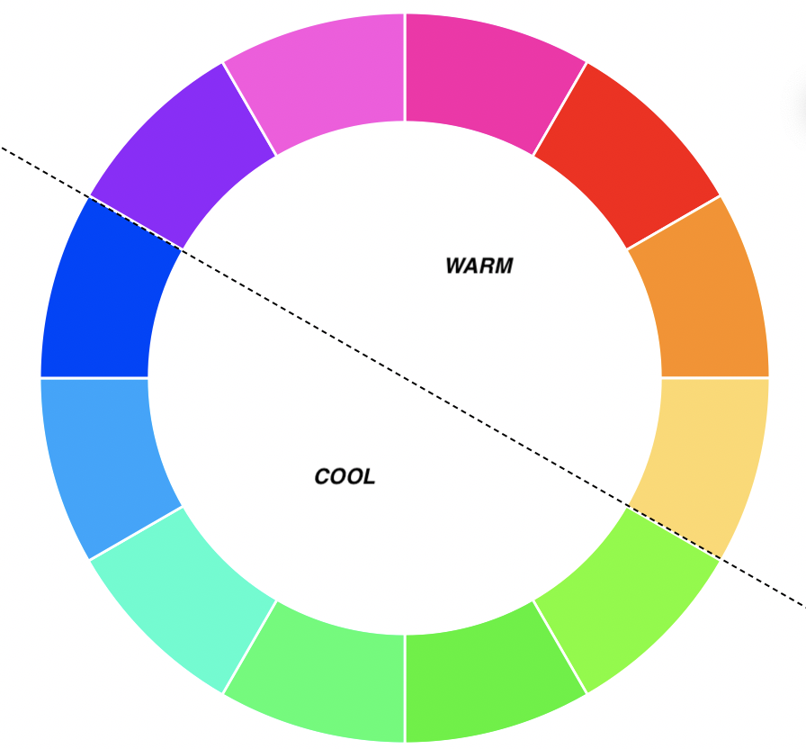
Use color to evoke emotion
Tip 12
Color evokes emotion, so choose the one that helps reinforce the emotion you want to arouse in your audience.
Warm colors | represent energy
Cool colors | represent calmness
Notes:
The purpose of this slide is to describe the theory behind the tip and how it can be enacted.

Slide 19

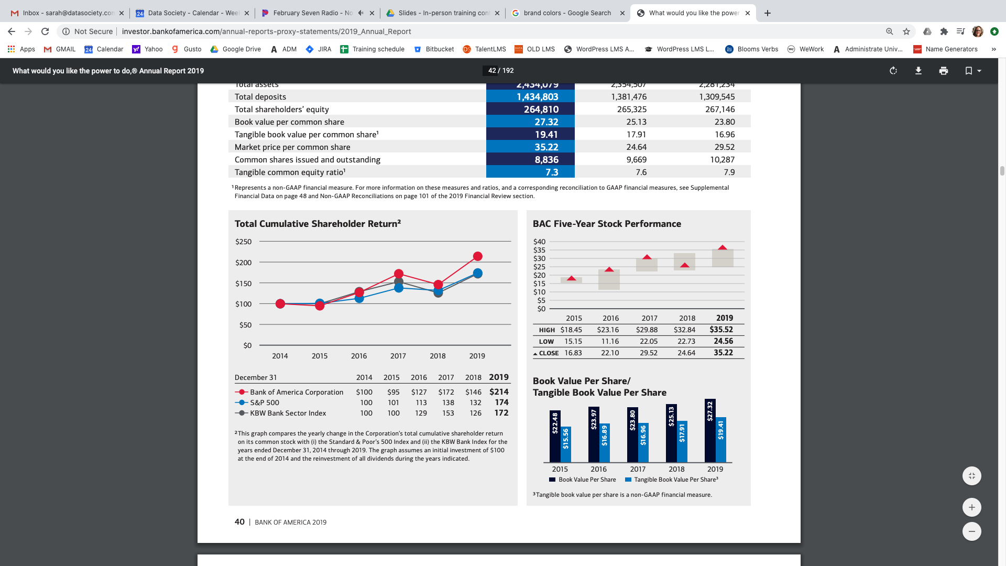
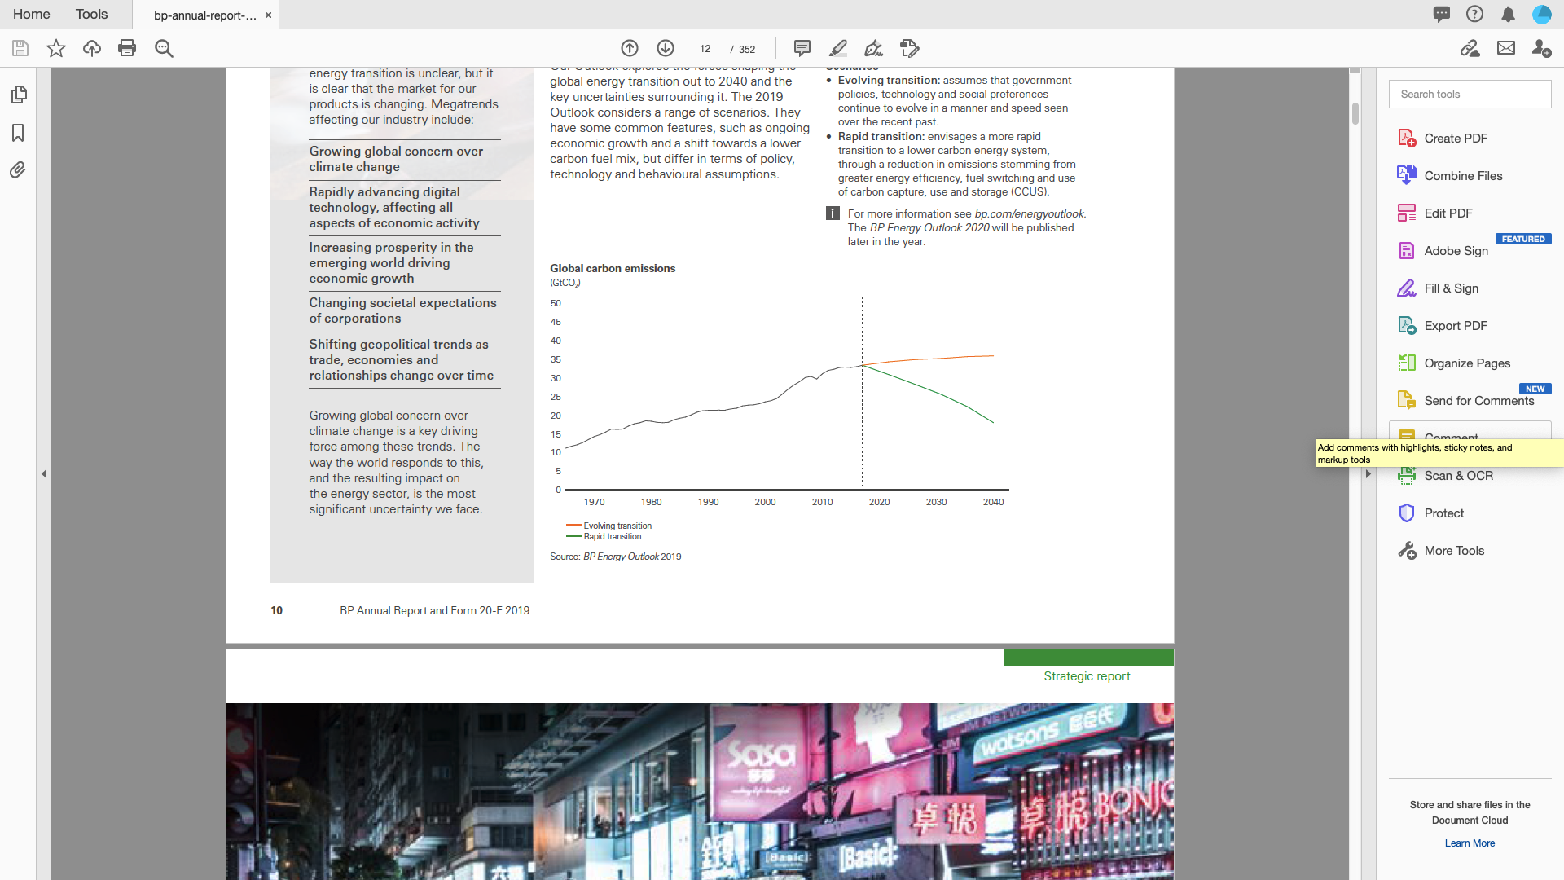

Use color to reinforce branding
Tip 13
If it’s necessary to use brand colors, select just one or two as “user-look-here” clues on an otherwise grey or black scheme.
Bank of America, 2019 Annual Report
Notes:
The purpose of this slide is to describe the theory behind the tip and how it can be enacted.

Slide 20
Encode data with color
Tip 14
Use color schemes to encode data as sequential, diverging, or categorical.
Sequential | Diverging | Categorical
when the order matters | to highlight minimums, maximums, and midpoints | for discrete data values representing distinct categories
Notes:
The purpose of this slide is to describe the theory behind the tip and how it can be enacted.

Slide 21
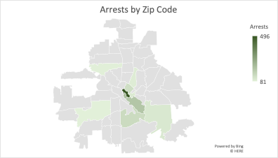
Sequential color schemes
Use a sequential color scheme when the order matters.
These schemes range between two colors—usually a lighter shade to a darker one—by varying one or more parameters such as saturation.
Notes:
The purpose of this slide is to describe sequential color schemes.

Slide 22
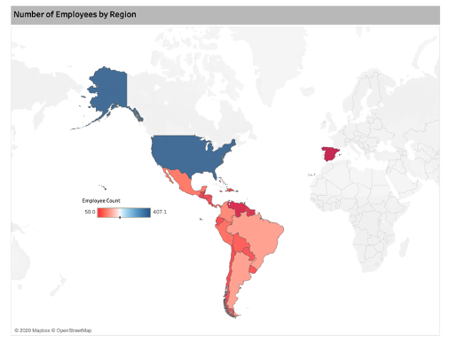
Diverging color schemes
Use a diverging color scheme to highlight minimums, maximums, and midpoints.
These schemes range between three or more colors with the different colors being quite distinct—usually having different hues.
Notes:
The purpose of this slide is to describe diverging color schemes.

Slide 23
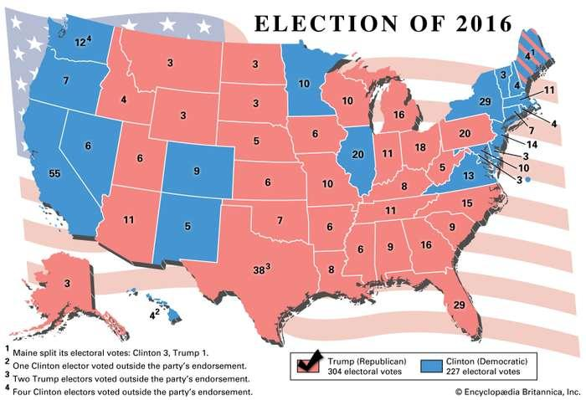
Categorical color schemes
Use a categorical color scheme for discrete data values representing distinct categories.
These schemes use different hues with consistent steps in lightness and saturation.
Notes:
The purpose of this slide is to describe categorical color schemes.
Image source: https://www.britannica.com/topic/United-States-presidential-election-of-2016

Slide 24
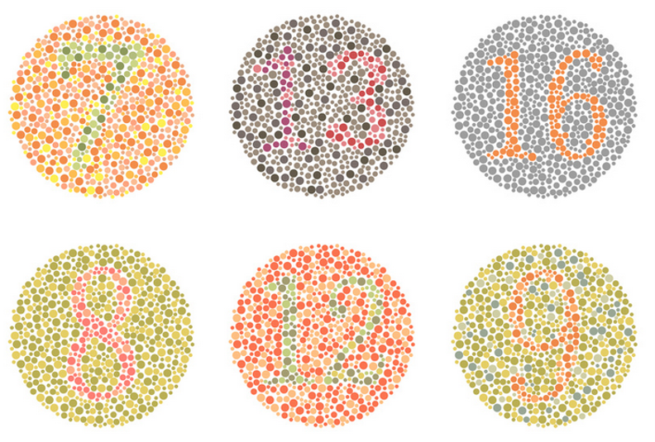
Don’t forget color-blindness
Tip 15
Color-blindness impacts roughly 8% of men and half a percent of women and results in difficulty distinguishing shades of red and green.
Design with color-blindness in mind by varying boldness, saturation, or brightness to distinguish colors.
Notes:
The purpose of this slide is to describe the theory behind the tip and how it can be enacted.

Slide 25
Recap
Choose a contrasting background
Make position meaningful
Group related items
Used closed regions to group
Distinguish different items
Arrange on a line
Address data gaps
Use natural positioning
Use labels and legends
Use size to show importance
Use color grab attention
Use color to evoke emotion
Use color to reinforce branding
Encode data with color
Don’t forget color-blindness
These 15 tips will help make data visualizations easier for the audience to read.
But remember, data visualization is an art. The guidelines may be broken intentionally to make a point!
Notes:
The purpose of this slide is to say (or reinforce) that these guidelines can be broken in certain situations since visualization isn’t an exact science.

Slide 26
Chat question
Where do you go for direction when designing a visualization?
What design standards do you follow?
Are there any resources everyone in this group should be aware of?

Slide 27
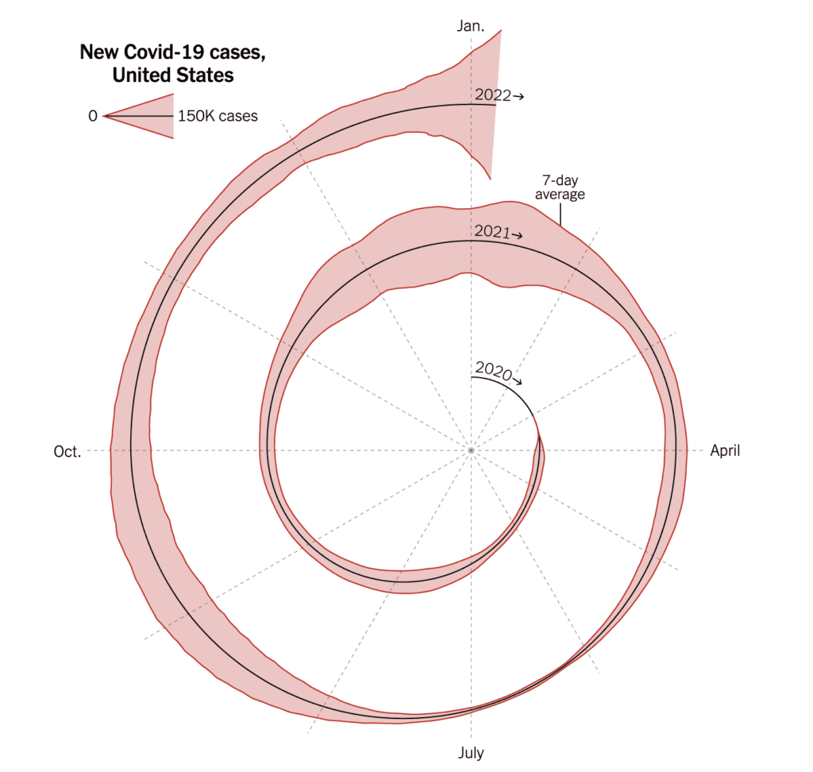
Evaluate the revision
Here is an eye-catching graph of covid cases between Jan 2020 – Jan 2022 that appeared in the New York Times and was much discussed on Twitter.
Chat question: What is this graph conveying?
Notes:
This is a spiral chart displaying the progression of Covid-19 cases in the U.S. from January 2020 (which is at 0) to January 2022.
The Covid cases increased from March 2020 and were high between November 2020 to Jan 2021.
However, there was a decline in the number of cases after that till it again started rising in July 2021.
Also, according to the last update, the cases were still increasing in Jan 2022.
Link to the New York Times article: https://www.nytimes.com/2022/01/06/opinion/omicron-covid-us.html

Slide 28
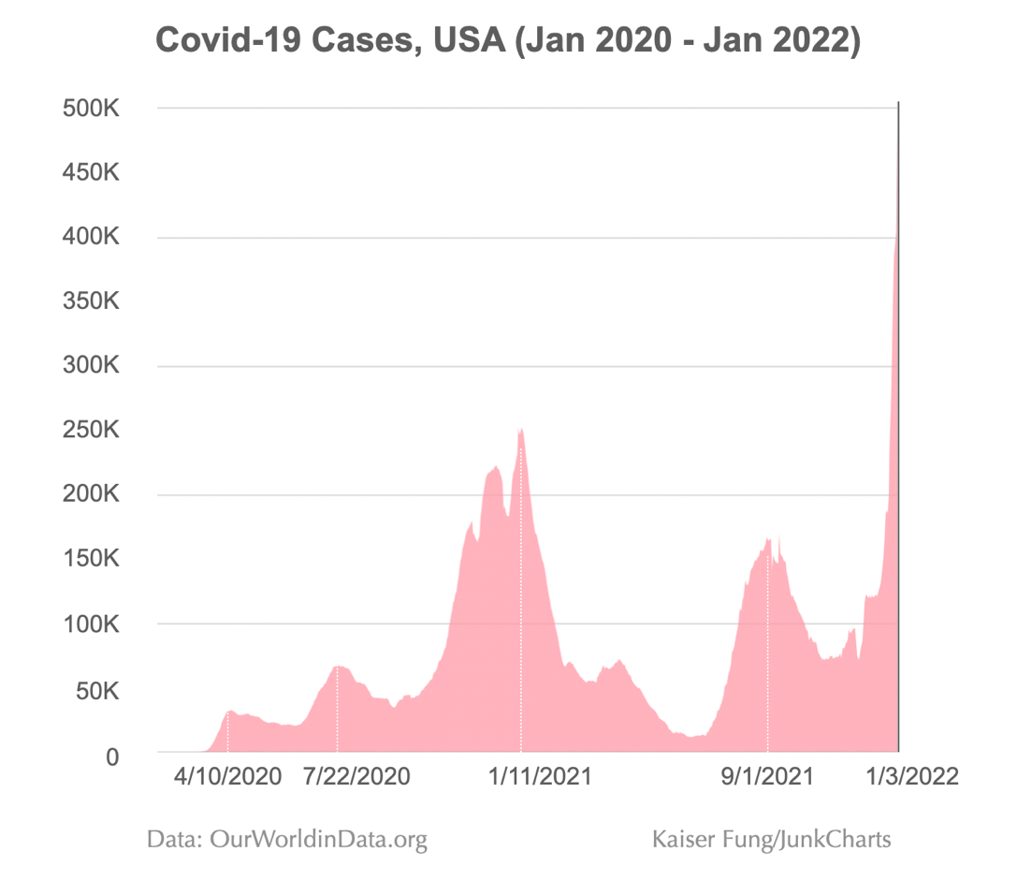
Evaluate the revision (cont’d)
Kaiser Fung, a leader in business analytics, data science, and data visualization, revised the graph to a time-series graph and thought it conveyed the data much better.
However, some experts had critical feedback on the reevaluated graph and thought it could represent the data better.
Notes:
The purpose of this slide is to present the revised chart by Kaiser Fung, who thought a time-series graph would better represent the data.
This visualization represents data from the beginning of the pandemic to January 3, 2022. Hence it displays an appropriate timeline.
However, some expert did have critical feedback on the revised version.
Go to the next slide as it has the tasks/questions that the students will work on in the breakout room.

Slide 29
In the chat, answer the following questions
Does the visualization benefit from Kaiser Fung’s editing? Why or why not?
What flaws do you notice in the revised graph? Is there any data that is left out or inconsistent in the revised graph?
Are there any elements that you can add or eliminate to improve the revised graph?
Is there another favorable way to visualize or present this data?
Notes:
Mention we will review answers at the beginning of the next session

Slide 30
Questions
3. Are there any elements that you can add or eliminate to improve the revised graph?
4. Is there another favorable way to visualize or present this data?
Notes:
Mention we will review answers at the beginning of the next session

Slide 31
Break

Slide 32
Visual design theory
Common mistakes
Misleading statistics and visual distortions
What problems make charts and graphs difficult to interpret?
Notes:
The purpose of this slide is to indicate the start of the section.

Slide 33

Common mistakes
Poor data visualizations confuse the viewer or, worse, mislead them and cause more harm than good.
Poor visuals can cause a loss of time and effort and might delay the decision-making process in deadline-driven projects.
Let’s talk about a few common mistakes.
Notes:
The purpose of this slide is to introduce the section.

Slide 34
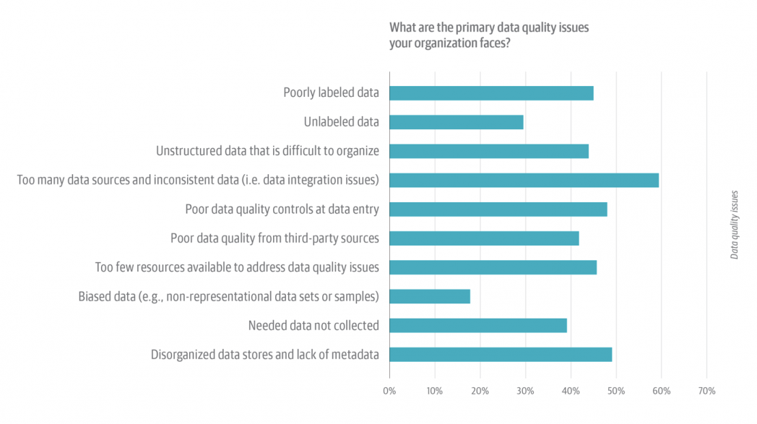
Visualizing bad data
2019 O’Reilly survey of more than 1,900 leaders and data professionals
https://www.oreilly.com/radar/the-state-of-data-quality-in-2020/
Visualizations are only as good as the data they represent.
Garbage in, garbage out!
Notes:
The purpose of this slide is to reinforce that visualizations are only as good as the data behind them.

Slide 35
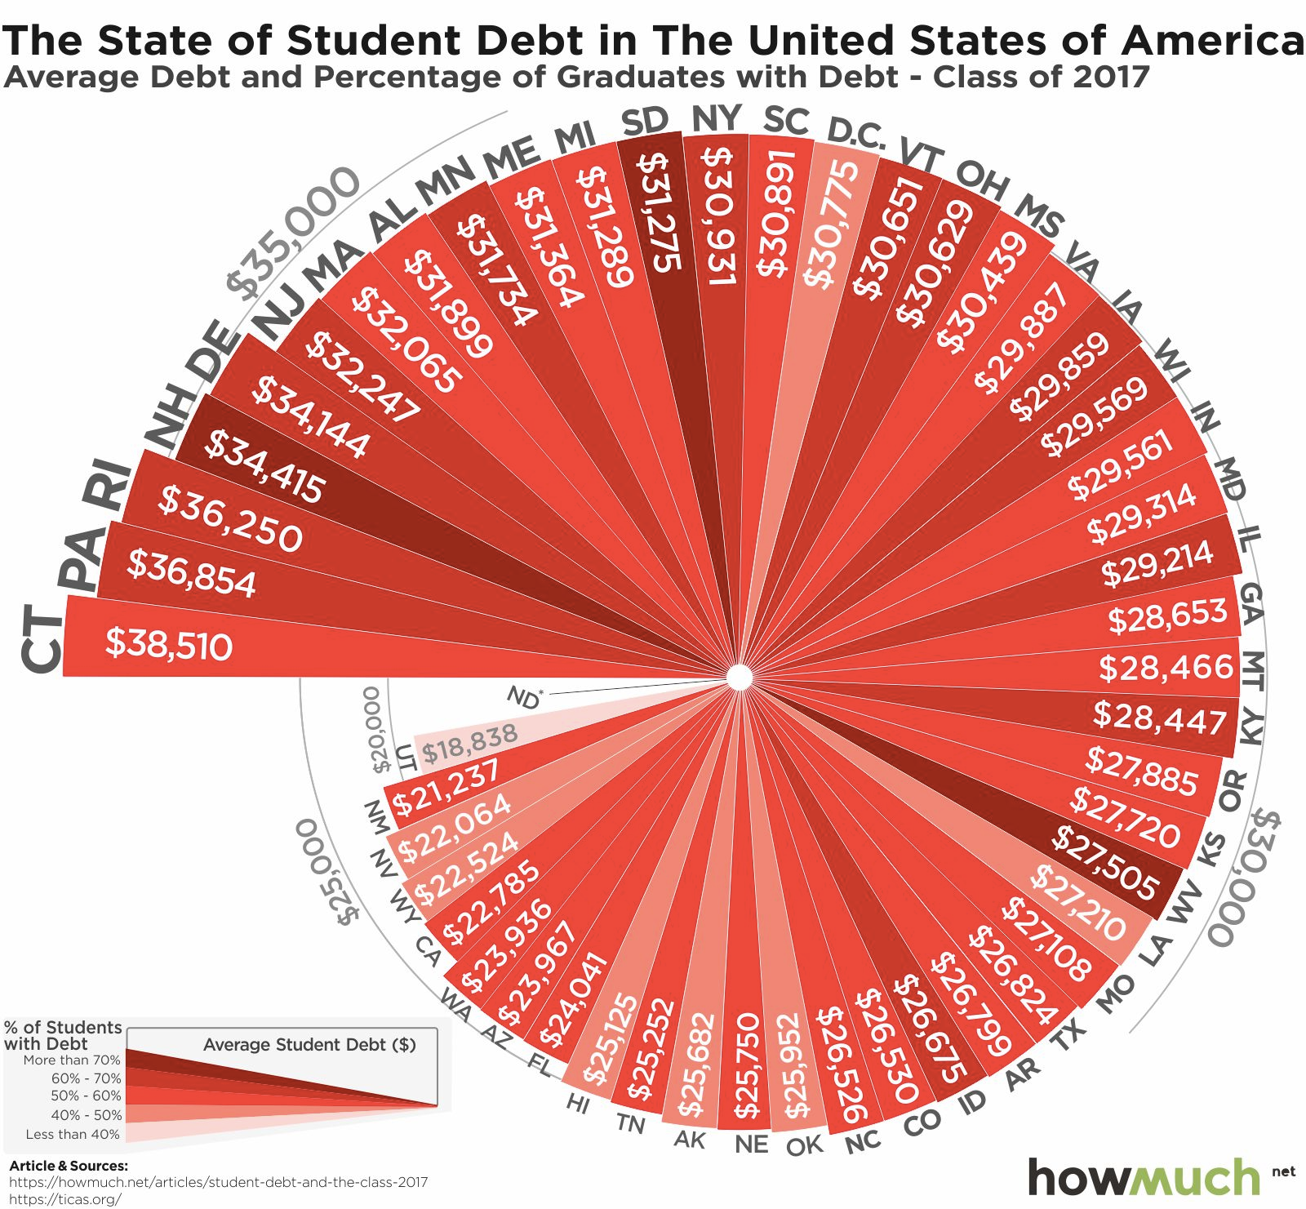
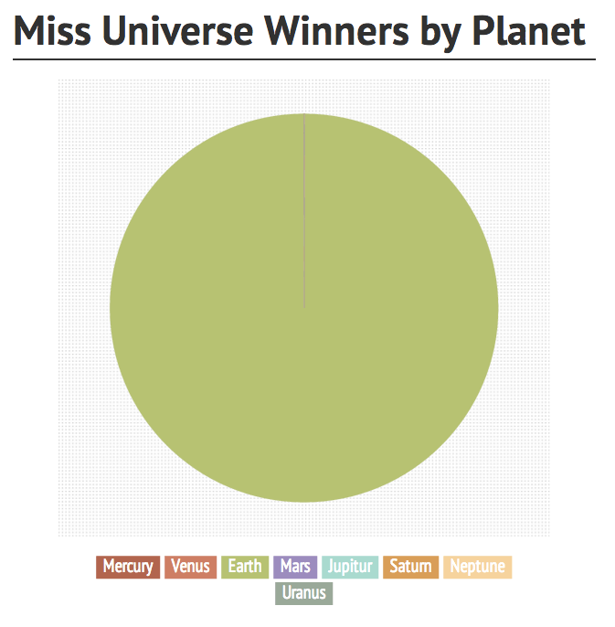
Misusing pie charts
https://howmuch.net/articles/student-debt-and-the-class-2017
https://trackmaven.com/blog/4-best-graphs-marketing-data
Notes:
The purpose of this slide is to talk about the misuse of pie charts.
ASK students to think about the first pie chart. STATE that there are too many segments make the pie chart difficult to read.
The viewer quickly loses interest when encountering a visualization that is challenging to read and interpret
We can improve this pie chart by using a bar chart and avoiding multiple colors for each department
ASK students to think about the second pie chart. STATE THE OBVIOUS that there is only one segment.
Could have used text. (Though maybe this is a case where intentionally breaking the rule makes a point.)
TELL students that pie charts work best with about 3 segments.

Slide 36
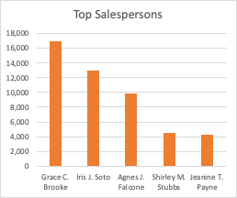
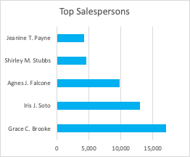
Interchanging column and bar charts
We may think it doesn’t matter if we use a column chart or a bar chart, but sometimes it does.
Bar charts are better when your data labels are long, to reduce clutter.
Column charts are better with negative values in your dataset.
Notes:
The purpose of this slide is to discuss that people often think it doesn’t matter if they use a column chart or a bar chart and give a few examples of when it does matter.
In the images the blue chart is less cluttered than the orange chart.

Slide 37
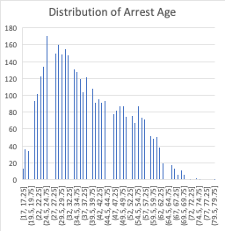
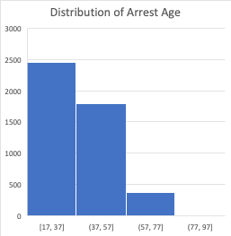
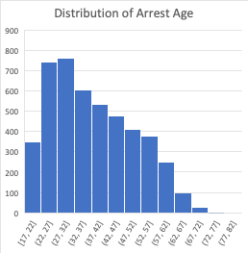
Using the wrong bin size in histograms
There is no right or wrong answer as to how wide a bin should be, but you need to make sure that the bins are neither too small nor too large to show patterns.
bin size = 0.25 years
bin size = 20 years
bin size = 5 years

Slide 38
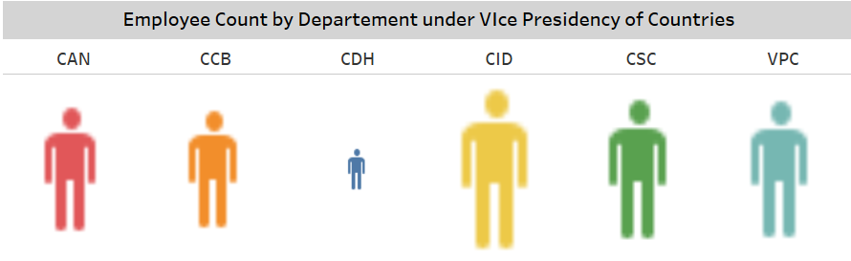
Making difficult comparisons
Sometimes we like using bright and colorful, graphic visuals to brighten up a mundane report. However, aesthetics should never supersede substance.
A plain, less creative column chart would be better to represent the information below.
Employee count by department
Dept A
Dept B
Dept C
Dept D
Dept E
Dept F
Notes:
The purpose of this slide is to reinforce that simple is best to get points across.

Slide 39
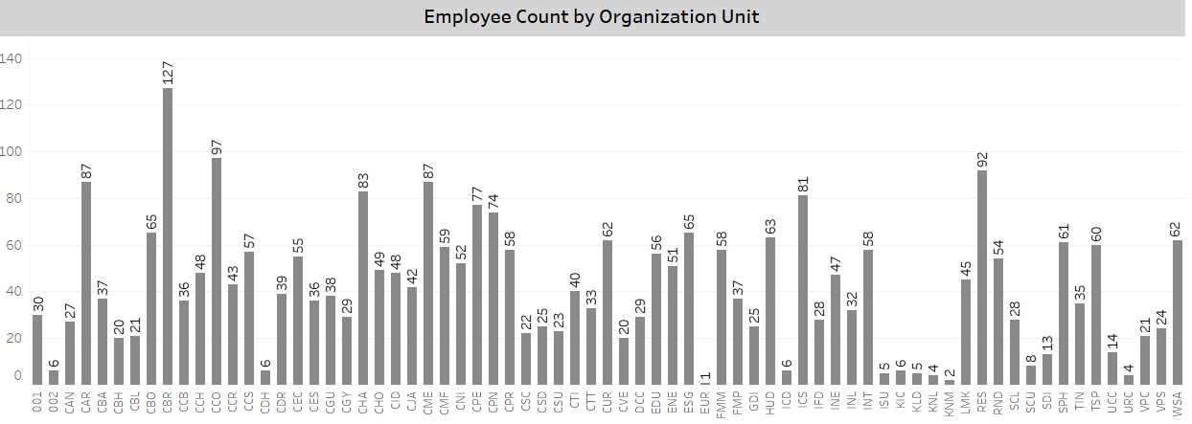
Plotting too much data
When there are many data points, visualizing data for the sake of visualization is counterproductive and unhelpful to the viewer.
The visualization below fails to properly compare employee count by location, and in cramming in too much information, is simply overwhelming.
A B. C. D. E. F. G. H. I. J. K L. M. N. O. P. Q. R. S. T. U. V. W. X. Y. Z. A1. B1. C1. D1. E1. F1. G1. H1. I1. J1. K1. L1. M1. N1 O1. P1. Q1. R1. S1. T1. U1. V1. W1. X1. Y1. Z1. A2. B2. C2. D2. E2. F2. G2. H2. I2. J2. K2. L2. M2. N2. O2. P2. Q2. R2. S2
Notes:
The purpose of this slide is to warn against plotting too much data.

Slide 40
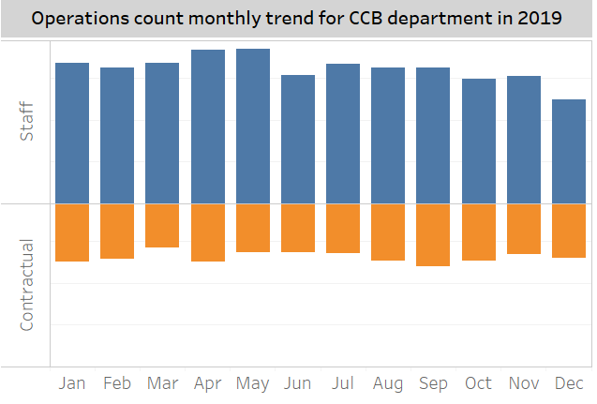
Not following conventions
Deviating from convention (such as green is positive and red is negative) can create confusion and misinterpretation of the facts.
What convention does this chart fail to follow?
Staffing trends - 2019
Notes:
The purpose of this slide is to warn against creating charts that don’t follow convention.
In the chart shown, the bars for “Contractual” staff move down and to the right—as if they are negative values. This makes it difficult for our brains to process. A stacked bar chart may be more effective.

Slide 41
Activity: class survey
Turn to page 18 of your participant guide to find the class survey – part III activity.
Review the results of the class survey that you all took earlier at: https://www.surveymonkey.com/stories/SM-WY5Y5RS2/
Note down any changes you might make to improve each visualization.
Notes:
Give the class about 10-15 minutes for this activity.
The slides that follow will help with debriefing the activity.

Slide 42
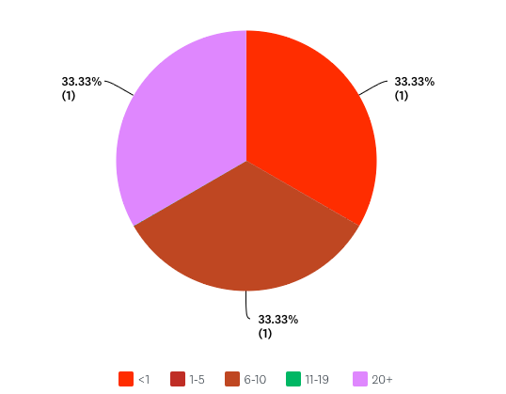
Visual 1
How many years have you worked for your current employer?
Chart type | Pie charts generally shouldn’t have more than 3 segments; consider a different chart type (if applicable)
Visual design | Colors are distracting; pick greyscale or branded colors
Clutter | Consider direct labeling the categories
Other

Slide 43
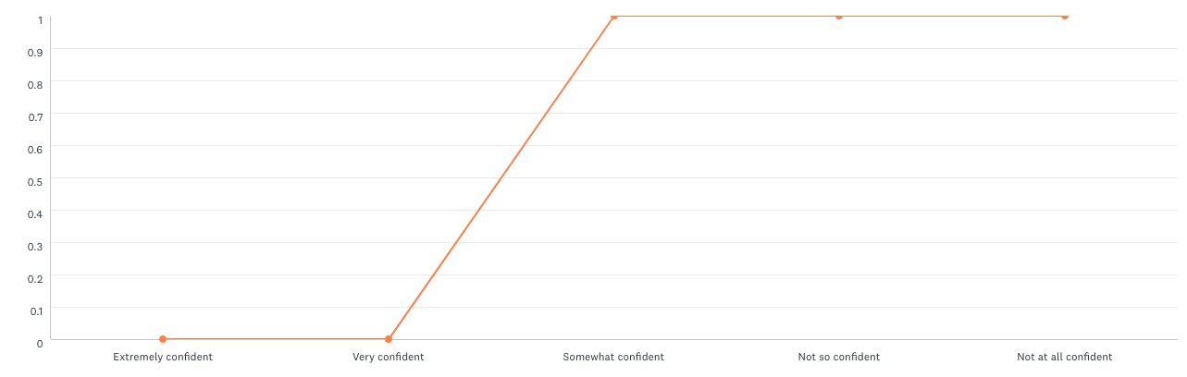
Visual 2
How confident are you in your ability to describe the difference between a histogram and a boxplot?
Chart type | Line charts are better for continuous data; it doesn’t make sense to use a line chart with categorical data
Visual design | Consider using data markers to reduce cognitive load
Clutter | Consider if the gridlines are necessary
Other

Slide 44
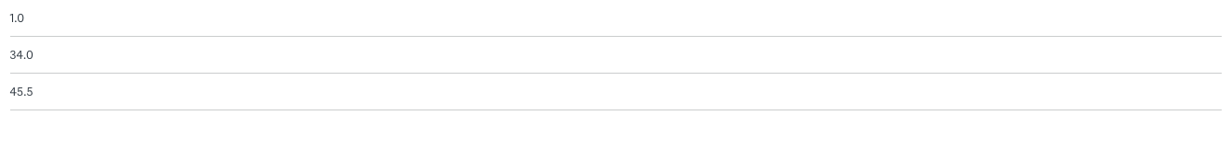
Visual 3
Roughly what percentage of your time at work is spent collecting, analyzing, or visualizing data?
Chart type | A table doesn’t help you understand the data; should be visualized.
Visual design
Clutter
Other | Data collection method may make visualization difficult
Notes:
Optional chat question: What if we had collected the data in a different way (e.g., as multiple choice instead of a short answers)--would that have changed the types of visualizations that were possible?

Slide 45
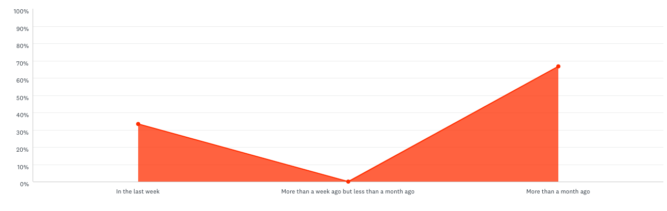
Visual 4
When was the last time you created a chart or graph to present data?
Chart type | An area chart doesn’t make sense for this type of data
Visual design | Consider using data markers to reduce cognitive load
Clutter
Other

Slide 46
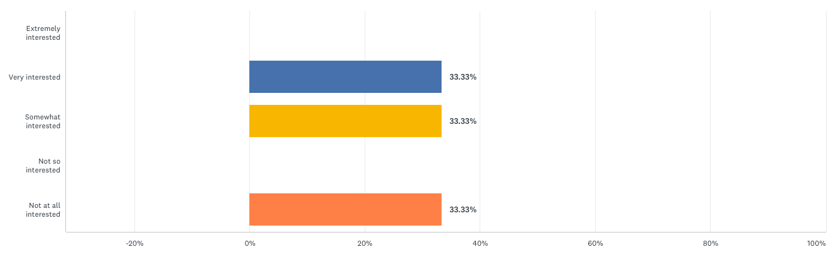
Visual 5
Are you interested in learning the Python programming language?
Chart type
Visual design | The axis shouldn’t go below 0 since that’s not a possible result
Clutter | Consider removing the ”Y” axis labels since it’s direct labeled
Other

Slide 47
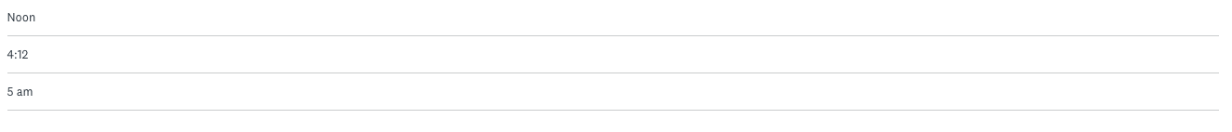
Visual 6
What time did you get out of bed today?
Chart type | A table doesn’t help you understand the data; should be visualized
Visual design
Clutter
Other | Data collection method may make visualization difficult
Notes:
Optional chat question: What would you have done differently during data collection to make this information easier to visualize? EXPECTED ANSWER: require a certain format or make multiple choice

Slide 48
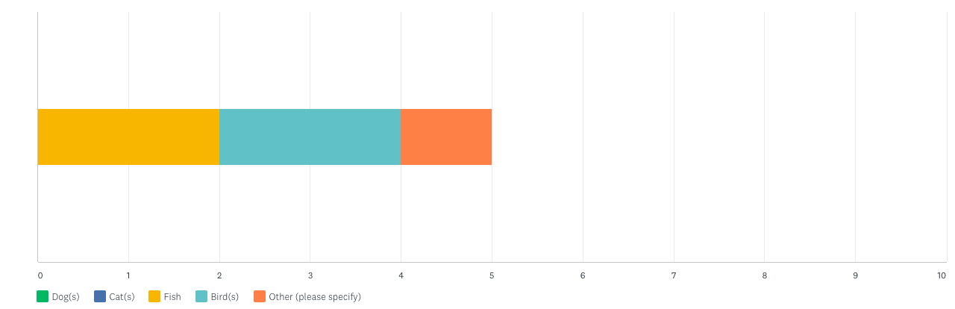
Visual 7
What types of pets do you own?
Chart type | This is not the best chart type for comparison
Visual design | Consider direct labeling instead of a legend
Clutter
Other | We can’t see what’s in the “other” category

Slide 49
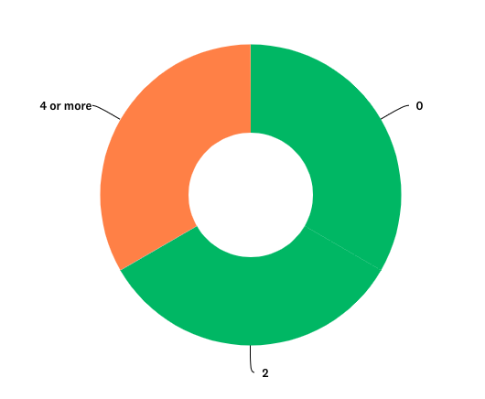
Visual 8
How many dogs do you own?
Chart type | Pie (and doughnut) charts generally shouldn’t have more than 3 segments; consider a different chart type (if applicable)
Visual design | Multiple categories use the same color making it difficult to distinguish them
Clutter
Other | Doughnut charts make sense when you want to utilize the middle space, which isn’t the case here

Slide 50
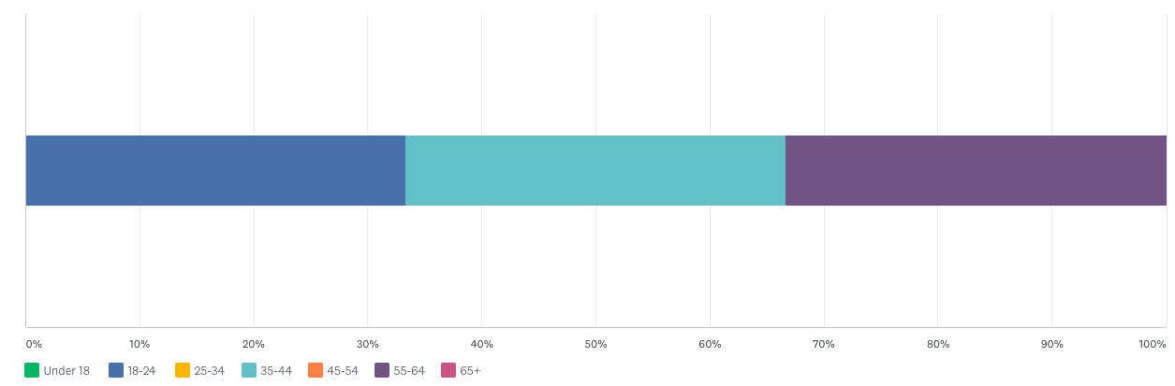
Visual 9
How old are you?
Chart type
Visual design | Consider direct labeling instead of a legend
Clutter
Other | Consider if, for your purposes, it’s better to present the data as a percentage or as a discrete value

Slide 51
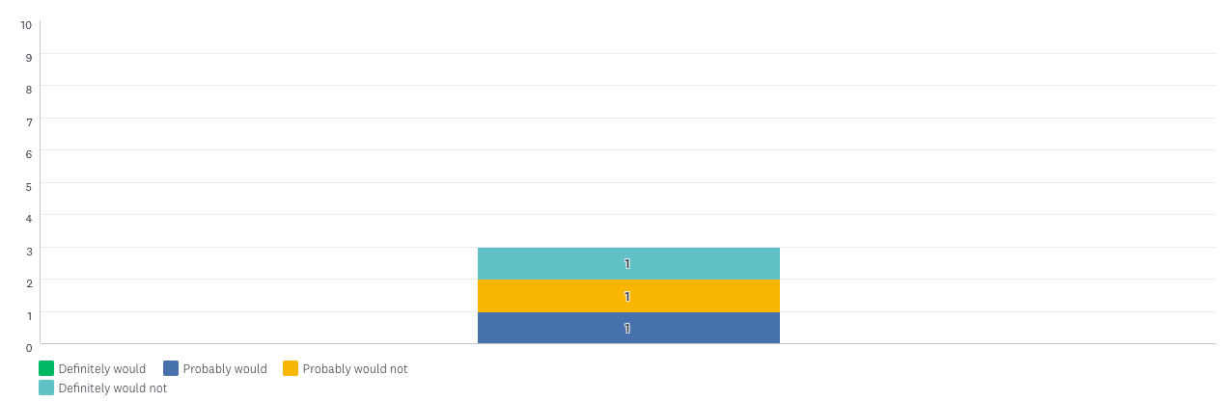
Visual 10
Would you ever go sky diving?
Chart type | It’s hard to “get” this chart within 30 seconds
Visual design | Consider direct labeling instead of a legend
Clutter
Other

Slide 52
Recap
Data visualization is an art, informed by science.
Use visual clues to make data visualizations easier for the audience.
Reduce visual clutter to lower the cognitive load and help transmission of the message.
See page 33 of the participant guide for a data viz checklist
Notes:
The purpose of this slide is to recap the last couple of sections section.

Slide 53
Visual design theory
Common mistakes
Misleading statistics and visual distortions
How can numerical data be used to mislead?
How can data visualizations misrepresent information?
Notes:
The purpose of this slide is to indicate the start of the section.

Slide 54

Misleading stats & visual distortions
Sometimes charts and statistics look presentable but could be misleading.
Unreliable data comparisons erode credibility and eventually dissuade viewers from using the analysis.
Notes:
The purpose of this slide is to introduce the section

Slide 55
Misleading
statistics
Notes:
The purpose of this slide is to indicate that we will talk about misleading statistics first.

Slide 56
Misleading statistics
“Bill Gates walks into a bar and everyone inside becomes a millionaire…on average.”
In 2011, the average income of the 7,878 households in Steubenville, Ohio, was $46,341. But if just two people, Warren Buffett and Oprah Winfrey, relocated to that city, the average household income in Steubenville would rise 62 percent overnight, to $75,263 per household.
What’s misleading about these statements?
https://www.nytimes.com/2013/05/26/opinion/sunday/when-numbers-mislead.html
Notes:
The purpose of this slide is to introduce the idea that not all summary statistics give an accurate picture.
Source: https://www.nytimes.com/2013/05/26/opinion/sunday/when-numbers-mislead.html

Slide 57
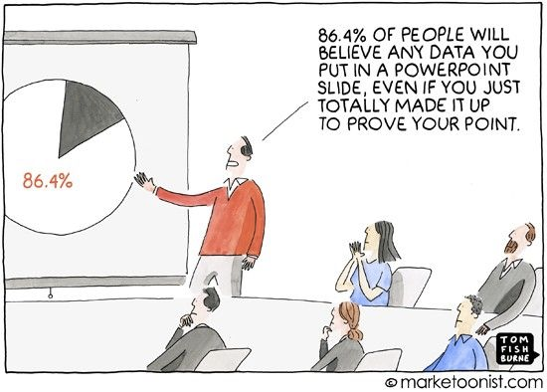
Misleading statistics
Numbers don’t have to be fabricated to be misleading.
Misleading statistics are the misusage—purposeful or not—of numerical data.
Notes:
The purpose of this slide is to introduce the idea that data doesn’t have to be made up for a visualization to be misleading.

Slide 58
Misleading statistics, ctd.
Misleading statistics can be created through issues with:
data collection
data processing
data presentation
Data collection | Small sample sizes Biased sampling Loaded questions
Data processing | No/poor data normalization Ignoring important features
Data presentation | Hiding context Omitting certain findings Visual distortions
Notes:
The purpose of this slide is to describe ways that statistics can become misleading.

Slide 59
Example: Bem’s PSI research
“I’m all for rigor, but I prefer other people do it. I see its importance—it’s fun for some people—but I don’t have the patience for it. If you looked at all my past experiments, they were always rhetorical devices. I gathered data to show how my point would be made. I used data as a point of persuasion, and I never really worried about, ‘Will this replicate or will this not?” (Daryl J. Bem, in Engber, 2017)
Want to read more? See page 35 of the participant guide for links to related articles.
Notes:
The purpose of this slide is to give the instructor a space to discuss Bem’s research and its flaws.
Source: https://theness.com/neurologicablog/index.php/follow-up-on-bems-psi-research/
Source: https://replicationindex.com/2018/01/05/bem-retraction/

Slide 60
How to avoid being misled?
Do some math. Are there any obvious mistakes?
Check the source. Is it creditable and current?
Question the methodology. Is there bias? Is the result statistically significant?
Conduct research. What does Google tell you?
Notes:
The purpose of this slide is to list questions that you should ask if you want to be a good consumer of statistics.

Slide 61
Visual distortions
Notes:
The purpose of this slide is to indicate that we will talk about misleading statistics first.

Slide 62
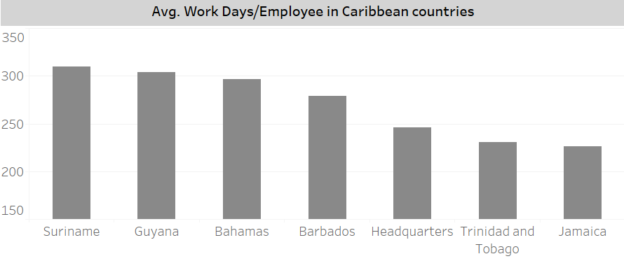
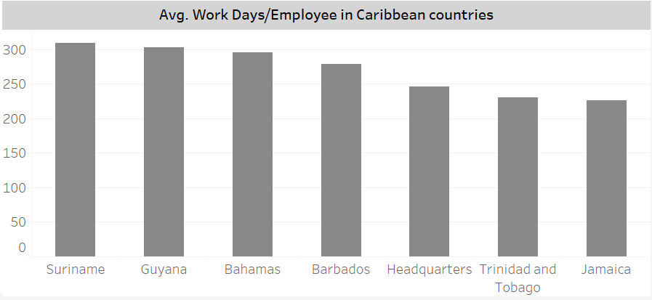
Visual distortions
Look at the top graph.
At first, Jamaica seems to have half the average workdays per employee that Suriname does.
In reality, the difference is much less.
What’s the difference between the two charts?
Notes:
The purpose of this slide is for students to think about what the visual distortion is.
The answer appears on the next slide.

Slide 63
Truncated graphs
One of the most common manipulations is omitting baselines or beginning the y-axis of a graph at an arbitrary number instead of 0.
This creates the impression that there is a significant difference between data points, when in fact, there is relatively little disparity.
Notes:
The purpose of this slide is to describe the visual distortion.

Slide 64
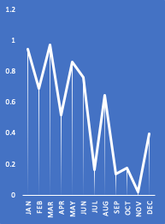
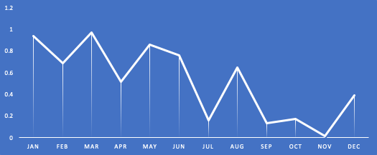
Visual distortions
What distortion has been used in these charts to change how the data appears?
Notes:
The purpose of this slide is for students to think about what the visual distortion is.
The answer appears on the next slide.

Slide 65
Exaggerated scaling
Exaggerating the scale of a line graph can easily minimize or maximize the change shown.
Notes:
The purpose of this slide is to describe the visual distortion.

Slide 66
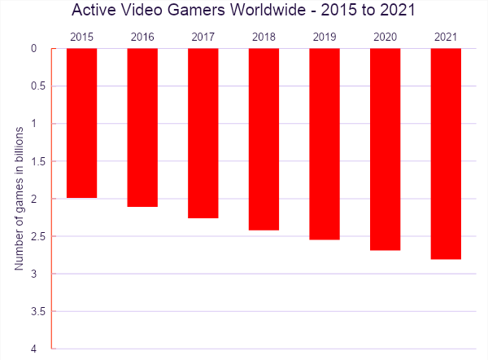
Visual distortion
How might this chart be misleading?
https://financesonline.com/number-of-gamers-worldwide/
Notes:
The purpose of this slide is for students to think about what the visual distortion is.
The answer appears on the next slide.

Slide 67
Ignoring convention
Deviating from convention (such as green is positive and red is negative) can create confusion and misinterpretation of the facts.
In this example, the axis also moves downward, making an increase in gamers look like an decrease, at a quick glance.
https://financesonline.com/number-of-gamers-worldwide/
Notes:
The purpose of this slide is to describe the visual distortion.

Slide 68
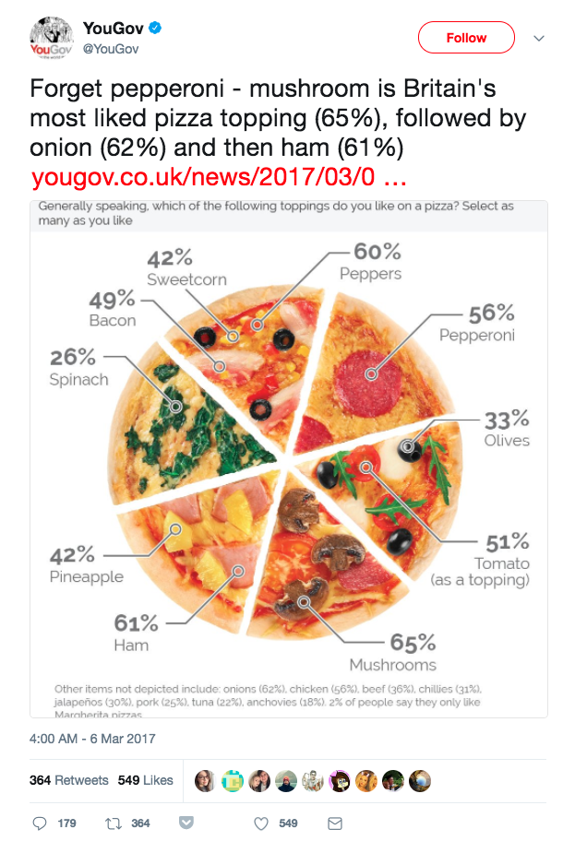
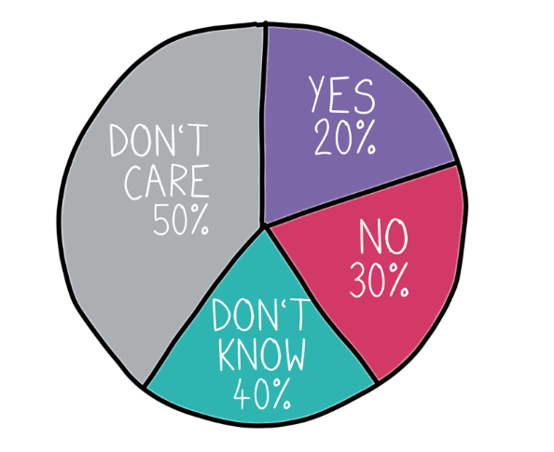
Visual distortion
What do you notice about these pie charts?
Notes:
The purpose of this slide is for students to think about what the visual distortion is.
The answer appears on the next slide.
Source: https://www.gov.uk/government/publications/a-bite-sized-guide-to-visualising-data-a-dstl-biscuit-book/a-bite-sized-guide-to-visualising-data

Slide 69
Numbers don’t add up
With pie charts, the sum of each slice must add up to the whole. When the numbers don't add up, you know there's an issue.
Notes:
The purpos
Source; https://www.gov.uk/government/publications/a-bite-sized-guide-to-visualising-data-a-dstl-biscuit-book/a-bite-sized-guide-to-visualising-datae of this slide is to describe the visual distortion.

Slide 70

Visual distortion
Does the S&D or the EPP party have more representation in parliament?
https://www.businessinsider.com/pie-charts-are-the-worst-2013-6
Notes:
The purpose of this slide is for students to think about what the visual distortion is.
The answer appears on the next slide.

Slide 71

3D distortion
3D pie charts can be used to distort and cause a misinterpretation of the data.
The same data is represented in both charts below.
https://www.businessinsider.com/pie-charts-are-the-worst-2013-6
Notes:
The purpose of this slide is to describe the visual distortion.

Slide 72


Visual distortion
Which company has a better sales trajectory?
Notes:
The purpose of this slide is for students to think about what the visual distortion is.
The answer appears on the next slide.

Slide 73

Improper extraction
Surprise! It’s the same company. One graph showed only odd years and the other only even.
To align to a particular narrative, some may choose to visualize only a portion of the data.
This is more common in graphs that have time as one of their axes.
Notes:
The purpose of this slide is to describe the visual distortion.

Slide 74

Visual distortion
What story does this visualization tell?
Notes:
The purpose of this slide is for students to think about what the visual distortion is.
The answer appears on the next slide.

Slide 75
Correlating causation
Data visualization can create causal links by the way that the data is presented to the viewer.
However, correlation does not equal causation.

Slide 76

Recap
To avoid being misled, look for:
misleading statistics
truncated graphs
exaggerated scaling
ignored conventions
numbers that don’t add up
3D distortion
improper extraction
correlating causation
Notes:
The purpose of this slide is to recap the section.

Slide 77
End of Day 3
Questions? Comments?

Slide 78
Data Visual Design & Storytelling
Day 4

Slide 79
The Joy of Stats

Slide 80
Evaluating a data story
What kinds of data was Rosling presenting in his story?
What storytelling techniques did you notice him use to make his story more compelling?
Do you think this was a good example of data visualization and storytelling? Why or why not?
Answer the questions in the chat.

Slide 81
Data storytelling
What is the basic structure of a data story?
What process can you use to compose a data story?
Notes:
The purpose of this slide is to indicate the start of the section.

Slide 82

What is data storytelling?
You focus on an insight and
persuade an audience
that the outcome of your analysis
demands a course of action
through narrative and visual communication.
Notes:
The purpose of this slide is to define data storytelling. Each of these five parts will be explored in greater detail in the material to come, beginning with how to focus on and refine an insight.
REMIND students that while much of the past two days have focused on the HOW of data visualization, telling a good story demands lots of thinking about the WHO (the audience) and the WHAT (the insight / outcome and course of action).

Slide 83
Data stories and data visualizations
A single data story may make use of multiple data visualizations.
Data stories arrange visualizations into the linear sequence of storytelling: a beginning, a middle, and an end.
Data story formats will likely incorporate other elements to explain and contextualize the visualizations:
prose text, either written or spoken
annotations, callouts, and labels
icons or graphics
images or photographs
Notes:
The purpose of this slide is to describe the relationship between data stories and their component data visualizations. Data stories are often more than the sum of their data viz parts because of sequence, explanatory text, and iconography / other images.

Slide 84
Can’t I just use a chart?
Narratives are super effective, “sticky” content delivery mechanisms.
Not everyone is a statistician, but they still want to make evidence-based decisions.
Stories let you overview key findings quickly.
Stories tap into both the logical and the emotional aspects of persuasion.
Notes:
The purpose of this slide is to emphasize the potential advantages stories have over visualizations without a storytelling framework.

Slide 85
Why choose story?
If your insight is...
A story can...
Unpleasant | Help convince your audience that even unwanted results are actionable.
Disruptive | Encourage your audience to break with tradition, if the upshot is valuable enough.
Unexpected | Explain why a prediction or intuition failed, and offer some analysis and a solution.
Notes:
The purpose of this slide is to focus on how stories can help mitigate problematic insights. EXPLAIN that not every insight is going to be welcome to your audience.
The chart continues on the following slide.

Slide 86
Why choose story?, ctd.
If your insight is...
A story can...
Complex | Guide your audience to a more complete understanding in manageable chunks.
Risky | Embolden your audience to take responsibility for making a tough choice.
Costly | Compel your audience to consider a high-cost solution by underscoring the high value.
Notes:
The purpose of this slide is to continue accounting for how stories can help mitigate problematic insights.

Slide 87
The data storytelling process
REFINE
TAILOR
OUTLINE
PLOT
FORMAT
Notes:
The purpose of this slide is to introduce the overall process we will encourage students to use to develop data stories.
EXPLAIN that data storytelling blends the science of data visualization with the art of narrative communication.
REASSURE students that following these five steps will help them to create data stories efficiently, focusing on one building block at a time.
CLARIFY that the orange arrows represent that sequence. But the light blue arrows are important too. If at any point in the process you need to return to a previous step to help get more clarity on the story you’re trying to tell, that’s okay. Just be sure to follow back through in order, rather than try to skip around.

Slide 88
Refining your
insight
Notes:
The purpose of this slide is to introduce the next section.

Slide 89
Step 1
REFINE YOUR INSIGHT
TAILOR
OUTLINE
PLOT
FORMAT
Notes:
The purpose of this slide is to reveal the first step of data storytelling: REFINING YOUR INSIGHT.
EXPLAIN that students should begin building their data stories in the middle rather than at the beginning. It sounds counterintuitive. But the most important part of the story, the big key takeaway, doesn’t generally come at the beginning.
REMIND students that the whole point of visualizing their data was to generate an insight, so it makes sense to begin with what they already have in hand.

Slide 90

Insight
Data stories are built around insights.
The same data visualization may reveal multiple insights
.
Notes:
The purpose of this slide is to present a case study for unpacking the idea that the same data visualization can reveal several different insights.
EMPHASIZE that any data story can only be built around one central insight.
This is a chart representing user satisfaction with five different features (A through E) of a hypothetical online banking app. ASK students to briefly consider how many different insights they can glean from this data.

Slide 91

Insight #1
Notes:
The purpose of this slide is to present one possible central insight: feature A most highly satisfies users.
EXPLAIN that the features have been reorganized in terms of the number of “very satisfied” responses, with feature A having the most.
PROPOSE that this could be the central point of a data story – but it is not the only possibility.

Slide 92

Insight #2
Notes:
The purpose of this slide is to present a second possible central insight: feature E satisfies the most users.
EXPLAIN that the coloring and ordering of the features has once again been altered, this time aggregating all users reporting a positive degree of satisfaction. Feature E edges out feature A because of the high aggregate.

Slide 93

Insight #3
Notes:
The purpose of this slide is to present a third possible central insight: features D and B are least satisfying to users.
EXPLAIN that the data visualization has been reorganized yet again to emphasize the lowest level of satisfaction.
NOTE that features D and B appear to be relatively close in terms of dissatisfaction.

Slide 94

Insight #4
Notes:
The purpose of this slide is to present a final possible insight: that feature D is the least used feature by a good margin.
EXPLAIN that the visualization has been altered to emphasize the number of users who reported not using each feature at all.
SUMMARIZE that these are four very different observations, but only one of them can be the most important. ASK: So how do you determine which one matters most?

Slide 95
Framing
In a data story, your insight is the most important piece.
What will make your audience perceive your insight as maximally:
Valuable: an observation that seems to be rewarding
Relevant: an observation that seems timely
Practical: an observation that suggests a realistic and feasible course of action
Specific: an observation that clearly and completely accounts for a problem
Make your insight as concrete and contextualized as possible
Notes:
The purpose of this slide is to recommend some parameters for determining how best to frame an insight and to prioritize which insight is central.

Slide 96
So what?
Each data story has one key actionable insight, the main idea to be communicated.
Why should your audience care?
What should they do about it?
What is the potential impact?
Notes:
The purpose of this slide is to get learners thinking about their insights in terms of audience and actionability.
EXPLAIN that a quote-unquote inherently compelling data point is less convincing than being able to account for why your listener should care and what your listener should do.
OBSERVE that for the sake of argument, we’re going to stick with the last possible insight because it seems most compelling: a feature that many people aren’t using at all is a problem.

Slide 97
Actionable insight
From this:
Feature D is the least used. So what?
To this:
Features B and D are about equally unsatisfying to users, but feature D is used 5 times less than feature B. We need to figure out why.
Note: you haven’t decided on an action yet. You’ve just increased the urgency to act.
Notes:
The purpose of this slide is to show how the language used to communicate an insight can be revised by asking the question “so what?” in light of the framing.
EXPLAIN that altering the prose explanation and the visualization together help transform the insight into something actionable.
CLARIFY that at this point in the storytelling process, you aren’t yet recommending a concrete action. You’re merely trying to maximize urgency, which we’ll discuss in more detail later.

Slide 98
Tailoring to your audience
Notes:
The purpose of this slide is to introduce the next section.

Slide 99
Step 2
REFINE
TAILOR TO YOUR AUDIENCE
OUTLINE
PLOT
FORMAT
Notes:
The purpose of this slide is to introduce the second step in crafting a data story, TAILORING THE INSIGHT TO THE AUDIENCE. That first means understanding how best to engage your audience and figuring out what they will find most persuasive.

Slide 100
Engaging your audience
AUTHORITY
GOALS
TIMING
EMOTION
REASON
Notes:
The purpose of this slide is to introduce a diagram representing the different ways you can appeal to an audience and thus better persuade them. These are also the different dimensions you might consider when trying to refine how you frame an insight.
For context, this is based on Aristotle’s rhetorical triangle, but it comes up routinely in literature on data storytelling (Brent Dykes’s Effective Data Storytelling, Cole Nussbaumer Knaflic’s Storytelling with Data).

Slide 101
Goals and priorities
What matters most to your audience?
What key objectives do they most focus on achieving?
What metrics inform their decision-making strategy?
GOALS
Notes:
The purpose of this slide is to offer students some questions to consider when assessing an audience’s goals and priorities.

Slide 102
Opportune timing
What are the most pressing concerns for your audience right now?
Is your insight best acted on in the short-term or the long-term?
Is interest in your insight high? Will it be higher later?
TIMING
Notes:
The purpose of this slide is to offer students some questions to consider when assessing the opportune timing for engaging with an audience.

Slide 103
Familiarity / reasoning
What domain knowledge and expertise does your audience have?
How would you rate their data literacy and comfort with stats jargon?
What kind of background will you need to provide?
REASON
Notes:
The purpose of this slide is to offer students some questions to consider when assessing an audience’s subject matter familiarity and investment in logical reasoning.

Slide 104
Beliefs and preferences
What relevant preexisting assumptions and attitudes does your audience have?
What data format does your audience like most?
What values and myths will you need to be prepared for?
EMOTION
Notes:
The purpose of this slide is to offer students some questions to consider when assessing an audience’s emotional orientation, especially their beliefs, preferences, and attachments (myths and values).

Slide 105
Power and authority
Is there a hierarchy to your audience that you must consider?
Whose say-so does your audience expect is most important?
Does your audience feel empowered to make change?
AUTHORITY
Notes:
The purpose of this slide is to offer students some questions to consider when assessing an audience’s attitude toward authority, including your own as a source of information as well as any internal power structures or party lines that will warrant concern.

Slide 106
Different audiences, different needs
AUTHORITY
AUTHORITY
GOALS
TIMING
GOALS
TIMING
EMOTION
REASON
EMOTION
REASON
Notes:
The purpose of this slide is to remind students that different audiences will find different elements of this diagram more persuasive than others. Telling a compelling data story means doing your best at the outset to recognize what an audience will respond to most.
The audience to the LEFT is much more persuaded by a demonstration of authority – maybe there is a strict hierarchy in place that you are near the top of, or they do not have much native expertise on the subject that you’re presenting about.
The audience to the RIGHT is much more persuaded by a demonstration of emotion – maybe there is a lot of fear because the stakes of their next decision are quite high, or maybe there is excitement over what they believe to have been a great project and they’re eager for data analysis.
Audiences will ALWAYS have goals and a sense of timing to keep in mind.

Slide 107
Diversity
Is your audience comprised of a mix of different people or teams?
Are their interests in concert, or are they competing?
Can you accommodate the diversity, or do you need multiple versions of your story?
Notes:
The purpose of this slide is to REMIND students that audiences are seldom wholly homogenous entities. You may need to try to construct a data story for a heterogeneous audience, with a diversity of interests. Sub-groups may also be persuaded / compelled by different appeals.
CONCLUDE by reminding students that once they have thoroughly analyzed their audience, they’re ready to move onto the next step of the storytelling process.

Slide 108
Outlining around the insight
Notes:
The purpose of this slide is to transition from considerations of tailoring an insight for an audience and positioning that insight within a data story structure.

Slide 109
Step 3
REFINE
TAILOR
OUTLINE AROUND THE INSIGHT
PLOT
FORMAT
Notes:
The purpose of this slide is to introduce the third step in crafting a data story, OUTLINING AROUND THE INSIGHT.
REMIND students that stories have beginnings, middles, and ends. They’re linear sequences of events. And they hinge on the insight you’ve tailored to your audience. That means you will need to create a rough outline of the story that positions the insight as a pivot point.

Slide 110



Transforming the key insight
OBSERVATION
INSIGHT
OUTCOME
Notes:
The purpose of this slide is to illustrate how the same piece of information transforms over the course of data analysis.
REMIND students that we’ve already talked about taking an observation and turning it into an insight.
EXPLAIN that in order to make that insight into the main event of a data story, it will be helpful to think of it as an outcome, the consequence of a problem.
This is a narrative trick, but also a logical one. Presenting someone with your key finding right off the bat may not allow you set up the insight with the right context to make it seem important!

Slide 111
The “aha” moment, or climax
Treating your key finding as both insight and outcome explains its central importance to your data story.
An insight is the beginning of something, a recommended course of action.
An outcome is the end of something, the diagnosis of a problem.
INSIGHT / OUTCOME
PROBLEM
ACTIONS
Notes:
The purpose of this slide is to explain what the term “outcome” means in the context of a data story.
EXPLAIN that while the insight is the beginning of a recommended course of action, an outcome is the end of the process of diagnosing a problem.
DEFINE the insight/outcome as the “aha” moment of your story, which makes it clear what kind of actions your audience ought to take. It also ought to be the climax of your story: the most valuable, relevant, practical, and specific articulation of a problem.

Slide 112
The rest of your story outline
Now that you know your audience, you can start telling them a story based on a few key parts:
Problem: What challenge does your outcome most concretely represent?
Actions: What can your audience do to fix the problem or change the outcome?
Measures: How will your audience know they’re achieving the desired outcome?
INSIGHT / OUTCOME
PROBLEM
ACTIONS
MEASURES
Notes:
The purpose of this slide is to define the other major components of a data story, the PLOT.
The PROBLEM comes before and culminates in the big reveal, the “aha” moment, of the climactic insight.
The ACTIONS come after the climax and serve as concrete recommendations of what an audience can do to resolve the problem or change the outcome.
The MEASURES are the metrics by which your audience can gauge their progress toward achieving the desired outcome.

Slide 113
Putting the outline together
INSIGHT / OUTCOME
ACTIONS
PROBLEM
URGENCY
MEASURES
Notes:
The purpose of this slide is to organize the different elements along a timeline. The rise toward the climax represents urgency, so that your insight/outcome is positioned at the moment of greatest possible audience buy-in and investment.
EXPLAIN that you can now see how each of the component parts of a data story relate to urgency:
The PROBLEM generates urgency before consistently increasing it over time. OBSERVE that this is not a jagged line, but a smooth and solid incline.
The INSIGHT/OUTCOME is the moment of maximum urgency, but also the moment where the story starts to ease off and resolve some of the tension.
The ACTIONS should be presented in such a way as to decrease the sense of urgency without reducing it back to baseline. Your audience still needs to feel compelled to do something, but they should also feel as though they are not totally powerless.
The MEASURES are a means of helping your audience establish a new baseline for urgency.

Slide 114
Dashboard developer outline
INSIGHT / OUTCOME
Key decision-makers barely use housing policy data at all.
ACTIONS
We believe this data source should be removed and replaced with a source more aligned with user needs.
PROBLEM
URGENCY
The initial objective was to create a data dashboard with maximally useful data.
We will re-survey users after removal and replacement.
MEASURES
Notes:
The purpose of this slide is to propose an outline of one possible data story tailored to the dashboard developers.
READ the four component parts in the sequence and point out how they illustrate the principles discussed on the previous slide.

Slide 115
Insight to outcome activity
Turn to page 24 of your participant guide to find “From insight to outcome” activity.
This activity builds on the results of the user satisfaction survey about the online banking app, which we discussed before.
Read the scenario and then write out how you would present your insights to the described audiences as an outcome. Then make some notes about how you would define the problem, actions, and measures for each audience.
Notes:
Before beginning this activity, REMIND students that this idea of putting the plot together in terms of a data story is something many of us do quite naturally without even thinking about it. We all tell and interpret persuasive stories all the time that follow these implicit rules. All we’ve done is make them explicit.
In this activity, students will be asked to create an outline for one of two stakeholder audiences in the data dashboard scenario. Assign each breakout group either public affairs team or bureau leadership.
GIVE students 15-20 minutes to complete this activity.
INVITE students to share their dashboard development team plans first. When they have shared, MOVE ON to the next slide.

Slide 116
Marketing team
Problem: Even though many users don’t actually use “email a representative” (feature D), those who do use it might be frustrated by its removal.
Outcome: Users who do make use of the “email a representative” (feature D), should be directed toward “direct message a representative” (feature B), which performs many similar functions.
Actions: Consider highlighting “direct message a representative” in some marketing materials. Create materials showing the removal of “email a representative” and its replacement. Gather more data on users of other features.
Measures: Surveying user awareness of “email a representative”’s removal, as well as user awareness of other enhancements.
Notes:
The purpose of this slide is to propose some possible solutions to the marketing team scenario. It is entirely possible that people have come up with different results.
EMPHASIZE the logical cohesion of these different points. The problem leads to the outcome, which leads to the action, which leads to the measures.

Slide 117
Head of technical support
Problem: Removing “email a representative” (feature D), will cause some users to experience problems with product functionality.
Outcome: Users who make use of “email a representative” (feature D), should be directed toward “direct message a representative” (feature B), which performs many similar functions.
Actions: Update current documentation to redirect users of “email a representative” to “direct message a representative” instead. Create additional support documentation for “direct message a representative”, including new enhancements.
Measures: Gathering information for tech support interactions involving “direct message a representative,” testing new “direct message a representative” documentation with current users of the “email a representative.”
Notes:
The purpose of this slide is to propose some possible solutions to the head of technical support scenario. It is entirely possible that people have come up with different results.
EMPHASIZE the logical cohesion of these different points. The problem leads to the outcome, which leads to the action, which leads to the measures.

Slide 118
Recap
Data stories:
are more memorable than stats or visualizations alone
are built around a clearly defined central insight
best compel an audience when they are tailored to its needs
set up a problem, reveal an outcome, then suggest actions and measures
Notes:
The purpose of this slide is to recap the section.

Slide 119
Break

Slide 120
Plotting with a storyboard
Notes:
The purpose of this slide is to introduce the section on storyboarding.
EXPLAIN that people often think of storyboarding as a trick of comic book artists and filmmakers. But storyboarding describes any process of representing different chunks of a story so that they can be manipulated, moved around, replaced, and discarded.

Slide 121
Step 4
REFINE
TAILOR
OUTLINE
PLOT WITH A STORY-BOARD
FORMAT
Notes:
The purpose of this slide is to introduce the fourth step in crafting a data story, PLOTTING WITH A STORYBOARD.
EXPLAIN that storyboards are useful because they help ground the general components of the outline in concrete plot points. In a data story, a lot of your storyboarding energy will be used on setting up the insight and determining how best to provide context, in the form of the problem.
We’ll begin by breaking down the parts of a good beginning to a data story.

Slide 122

Plotting with a storyboard
It’s okay for your data story to remain flexible at this early stage.
There are no right answers, only consideration and iteration.
Focus on building the elements of the story first, on paper.
Try out different versions quickly and don’t get too attached.
122
Notes:
The purpose of this slide is to encourage students to build the pieces of their story in low-tech fashion.
Not sinking time into elaborate visualizations at the outset means a higher degree of flexibility, a lower degree of attachment to a draft or version, and deeper consideration of the audience’s needs and priorities.
EMPHASIZE iteration. The beauty of a storyboard is that you can move pieces around, improve them, or throw them away quickly. Versioning can be very productive!

Slide 123
Refine your insight
Step 1
By this point, your key takeaway should be succinct, tailored to the audience, and actionable.
Position it at the climax of your data story. It’s the most valuable and most relevant insight, and it’s the “big reveal” your story is building toward.
INSIGHT / OUTCOME
Notes:
The purpose of this slide is to describe the first step of building a storyboard. In effect, this is what we have already tried to do so far today: refine an insight, tailor it to an audience, and position it at the climax. This is our first plot point.

Slide 124
Define your hook
Step 2
Head down to the moment the urgency starts ramping up. This is the hook, your initial problem.
What concrete observations first pointed you toward the insight? Often, these come in the form of an anomaly, shift, or change.
INSIGHT / OUTCOME
HOOK
Notes:
The purpose of this slide is to describe the second step of building a storyboard, selecting a hook.
REMIND students that they’ve already thought about the PROBLEM to which the insight is also the outcome.
They can now choose a concrete observation that first can point an audience toward the insight. This is often an anomaly, a shift, or a change – some kind of irregularity.

Slide 125
Prepare your hook with setting
Step 3
Take one step (but only one step) backward, to the very beginning of the story.
What background information does your audience need to feel that hook sink in? What is the usual situation that the anomaly, shift, or change deviates from?
INSIGHT / OUTCOME
HOOK
SETTING
Notes:
The purpose of this slide is to describe the third step of building a storyboard, preparing the hook with a setting.
If the hook is an irregularity, then there needs to be some kind of “business as usual” from which that data point deviates.
What background information does your audience need to know to register the hook as unusual?
CLARIFY that the audience often does not need to know everything. Perhaps they only need to know one or two things, depending on their level of familiarity.

Slide 126
Select and sequence beats
Step 4
Now it’s time to get your audience from your hook all the way up to your insight – to make it seem like the appropriate outcome of your analysis.
Which data points will best build urgency? In what order should you present them?
INSIGHT / OUTCOME
SETTING
Notes:
The purpose of this slide is to describe the fourth step of building a storyboard, selecting and sequencing the data points that will build the urgency from your hook to your insight.
REMIND students that they will probably have more data points than they need based on their exploratory analysis.
EMPHASIZE that the goal is to produce a logical, emotionally compelling sequence that constantly and consistently increases urgency. The simplest sequence is often the best.

Slide 127
Beats = data points
When storyboarding, describe or sketch the visualizations and beats.
Focus on selecting and sequencing the most relevant data points.
Comparison | Composition | Distribution | Relationship
Change over time Projection | Zoom out Drill down | Cluster Outlier | Intersection Projection
Notes:
The purpose of this slide is to explain what some of these beats might look like, as data visualizations, in terms of the different functions they might perform in the story.
COMPARISON data viz highlight changes over time and projections into the future.
COMPOSITION data viz allow for zooming out to see a whole or drilling down into a part.
DISTRIBUTION data viz allow for highlighting clusters and outliers.
RELATIONSHIP data viz allow for highlighting intersections of groups and projecting into the future.
EMPHASIZE that storyboarding only requires a description or sketch of the desired visualization. The reason is that you don’t want to sink time into making viz when you need to get the sequence right.

Slide 128
Scenario: ordering your beats
Employment level and taxable business income are satisfying
Housing policy data is least useful and dissatisfying
Credit card and housing policy data are unsatisfying
Differences in satisfaction
We assessed user satisfaction for 5 major data sources
Notes:
The purpose of this slide is to show the importance of logically ordering the beats between the hook and the climax.
EXPLAIN that this is a possible storyboard for the development team in our scenario. WALK THROUGH the text for each of the plot points from setting to the insight/outcome.
We can even IMAGINE the different visualizations for each beat as stacked bar graphs like the ones we’ve already seen.
The HOOK shows satisfaction for all 5 data sources.
The FIRST BEAT highlights low satisfaction for two data sources.
The SECOND BEAT highlights high satisfaction for employment level and taxable business income.
The INSIGHT / OUTCOME focuses on housing data as least used.
Storyboarding allows you to quickly and easily swap data points when there might be a more compelling sequence. NOTE what happens to the urgency here – it looks like it wavers a little bit.

Slide 129
Reordering your beats
Credit card and housing policy data are unsatisfying
Housing policy data is least useful and dissatisfying
Employment level and taxable business income are satisfying
The outcome concerns what to do with unsatisfying data.
It’s more compelling to begin with high satisfaction, then move on to low satisfaction.
Differences in satisfaction
We assessed user satisfaction for 5 major data sources
Notes:
The purpose of this slide is to improve upon the previous diagram by changing the order of the two beats between the hook and the climax.
EXPLAIN that because the outcome concerns what happens with unsatisfying, even comparatively unused data, it is more compelling to build a narrative about data that becomes less satisfying and less useful. Interrupting the story with satisfying data breaks the momentum.

Slide 130
Offer your course of action
Step 5
Good stories don’t end on a climax. They resolve some tension by proposing a solution.
What steps would you recommend taking? What options should be considered? What preference stands out? What measures seem relevant?
INSIGHT / OUTCOME
COURSE OF ACTION
SETTING
Notes:
The purpose of this slide is to describe the fifth step of building a storyboard, outlining a course of action.
EXPLAIN that a well-defined course of action will often take the form of a series of steps and sub-steps, as well as the measures that the audience should use to gauge their progress.
Sometimes the best solution is to just open the lines of communication. If you’re telling a data story face-to-face, your only goal may be to solicit feedback or answer questions that arise.
The ultimate goal is to reduce, but not eliminate, urgency.

Slide 131
Format your data story
Step 6
You now have a complete data story! But it still doesn’t have any visuals. That’s okay.
Before choosing visuals, you need to think about the overall communicative situation.
INSIGHT / OUTCOME
COURSE OF ACTION
SETTING
Notes:
The purpose of this slide is to describe the sixth and final step of building a storyboard, formatting the data story. That means crafting and tailoring the narrative – and the visuals – to a specific communicative situation.
EXPLAIN that virtually all of this storyboarding process has taken place without creating data visualizations – and that’s a good thing! Sinking time into visuals or getting overly wedded to specific tools before thinking about the communicative situation can make for lots of wasted time.

Slide 132
Formatting for delivery
Notes:
The purpose of this slide is to introduce the next section on formatting.
EXPLAIN that the term “story” is pretty vague. Stories can happen in books, in movies, as a string of text messages, or as conversations over dinner. And in each of those different formats, your expectations about how a story is structured, and what kind of participation you can count on, is different.

Slide 133
Step 5
REFINE
TAILOR
OUTLINE
PLOT
FORMAT FOR DELIVERY
Notes:
The purpose of this slide is is to introduce the fifth and final step in crafting a data story, FORMATTING FOR DELIVERY.
EXPLAIN that the word “delivery” doesn’t just mean how you’re going to send a file off to someone. It means how you’re going to present the story. Is it live, in front of an audience? Is it printed and disseminated by mail? Is it on a website that anyone can access at any time?

Slide 134
Direct vs. indirect communication
Being able to interact with your audience changes how you tell a story
Direct communication affords you a high degree of flexibility and control over the story
adjust pace, drill down, pull back, respond to audience feedback in real time
Indirect communication affords you a high degree of detail and text
annotate, explicate, provide as much context as your reader / viewer / listener needs
These affordances are inversely relational
Notes:
The purpose of this slide is to explain the difference between two kinds of communicative situations: direct and indirect.
EXPLAIN that the degree to which you will be able to interact with your audience has a direct effect on how you design your visuals and craft your accompanying explanatory text.
Affordance is a term borrowed from design theory to describe the property of an object or environment relating to its potential use.

Slide 135
Formatting for delivery
You may find yourself needing to alter the way you tell your data story based on the affordances of the format.
Sometimes the format is a given, but other times, it will depend upon your input and the use case.
As with visualizations, the simplest storytelling format is often the best.
Slide deck | Document | Interactive | Hybrid
Sequence of slides intended for real-time presentation | Illustrated text (report, infographic) to be read anytime | Digital object intended to align function with user experience | Blend / compromise of at least two formats
Notes:
The purpose of this slide is to outline some of the main considerations in approaching the formatting stage of data storytelling.
Example formats include slide decks, documents, interactives, and hybrid. Each of these formats could easily be its own course, but the purpose today is just to mention them:
Slide decks are often used in a direct communication context.
Documents and interactives tend to be used in indirect communication environments.
Hybrid forms are often designed to be flexibly used in both contexts.

Slide 136

Same story, different formats
For explanatory purposes, sample story formats drawn from a single source
By comparing how similar data points are represented in different formats, we can better understand how format affects storytelling
More information about Selfiecity can be found here
Notes:
The purpose of this slide is to explain the structure of the next several slides.
EXPLAIN that for the sake of seeing why formatting matters, and for ease of visualizing the different affordances of various formats, all of the examples are taken from the same source, a project called SELFIECITY.
DESCRIBE how Selfiecity’s researchers gathered a set of photographs from five major cities worldwide in order to draw conclusions about demographics, poses, and expressions.

Slide 137

A sample slide
Notes:
The purpose of this slide is to show off a sample slide from a slide deck.
NOTE that it only represents a single data point and offers limited clarification. EXPLAIN that it probably doesn’t even make much sense just on its own. That’s because for a slide deck, what appears on screen is only a fraction of the overall communicative situation.

Slide 138
Sample slide 1, with script
Slide 1: “Our first observation was surprising. We found that, despite stereotypes in the media, people take fewer selfies than is often assumed.
Depending on the city, only 3-5% of the images we analyzed were actually selfies. The rest were photos of other objects: cats, food, cars, houses, feet, other people… You name it, we saw pictures of it, whether we wanted to or not.”
Notes:
The purpose of this slide is to emphasize the relative importance of the narration script that accompanies a slide.
EXPLAIN that the data point itself is represented by the orange text. The rest of the contextualizing information is narrative.
The narrative prose includes some information about beliefs and expectations (“media stereotypes”), a clear replacement of those false beliefs with a new data-based belief, and even a joke in the final sentence.

Slide 139

Sample slide 2, with script
Slide 2: “But in each of the five cities we analyzed, we found significantly more women taking selfies than men. There was quite a range here.
You can see that women in Bangkok were 1.3 times as likely as men to take selfies, they were 1.9 times more likely in Berlin… all the way up to 4.6 times more likely in Moscow. That’s about 5 selfies of women for every one of a man.”
Notes:
The purpose of this slide is to show that the script might synthesize data differently than the accompanying visual on a slide.
EXPLAIN that, again, the main data takeaway is in orange. But rather than reading out the sequence of percentages, the script allows the speaker to explain the relationships between different subsets (1.3 times, 1.9 times, 4.6 times, 5:1 ratio).

Slide 140

Slide deck
Primarily visual medium, <50 words per slide
Accompanying script provides explanation
Presence of audience means negotiating pace, interruptions, digressions, and questions
Build suspense across slides
Notes:
The purpose of this slide is to outline some of the distinctive affordances and constraints of slide deck design.

Slide 141

Slide deck, ctd.
Slide decks use headers and section slides to focus audience attention.
Some slides may only contain a single line of text, or a single image, photo, or icon.
Notes:
The purpose of this slide is to explain how slide decks focus audience attention, as well as to reinforce that not every slide needs to be (nor should be!) a data visualization.
The image represents a transitional slide that allows the presenter to focus on the next topic in the presentation, guiding audience attention and building urgency.

Slide 142

A sample infographic
Notes:
The purpose of this slide is to show off a sample infographic derived from the same dataset.
NOTE how explanatory text needs to accompany each visualization. Note also that the text is organized under headings, that certain takeaways are in boldface, and that the colors of header text and body text are subtly different.

Slide 143

Document - infographic
Primarily visual medium, <50 words of explanation per visual
Visuals feature easily interpretable callouts, icons, titles, labels, and annotations
Text itself is treated as a visual
Key takeaways at top, but build urgency vertically / downward
Notes:
The purpose of this slide is to outline some of the distinctive affordances and constraints of infographic documents.

Slide 144

Document – infographic, ctd.
Infographics use section headers, size, shape, and color scheme to focus attention
Some beats may only consist of text, an icon, or an image, rather than a chart or graph.
50%
The average amount that women
tilt their heads more than men in selfies
Notes:
The purpose of this slide is to outline some of the distinctive affordances and constraints of infographic documents.
EXPLAIN that not every visual in an infographic needs to be a chart or graph. Sometimes annotated iconography, like this image, is entirely sufficient.

Slide 145


A sample report
Notes:
The purpose of this slide is to show off a sample report.
EXPLAIN that text is organized and sequenced into paragraphs that appear under headings. The accompanying visualization is also relatively complex.

Slide 146

Document – report
Primarily textual medium, high word count blocked out as paragraphs
Visuals can have greater informational density – if they’re thoroughly explained
Visuals function as illustrations of the surrounding explanatory text
Begin with summary, then sequence of sections, then conclusion
Notes:
The purpose of this slide is to outline some of the distinctive affordances and constraints of report documents.

Slide 147
Document – report, ctd.
Reports use a table of contents, titles, section names, and headers to focus attention
Individual images may also be given captions to more succinctly restate their purpose than the surrounding text
What can selfies show us?
How many photos are selfies?
Do men or women take more selfies?
How old are selfie-takers?
How many selfies display smiles?
What methodology did we use?
Notes:
The purpose of this slide is to outline some of the distinctive affordances and constraints of report documents.
The image represents a table of contents, which might also be modified to include page numbers if the report appears in a printable format.

Slide 148

Hybrid (a.k.a. slides without a show, or a visual report)
Notes:
The purpose of this slide is to highlight the difficulty of producing a hybrid document, like a slide deck intended for reading in lieu of a report.
EXPLAIN that hybrid documents must try to blend the affordances and constraints of different formats. It takes extra effort to make sure that the blending doesn’t compromise the efficiency of its parts.
OBSERVE that this frame from a slide document has far too much text to be an effective slide. The dimensions of the document also require readers’ eyes to bounce from top to bottom, between data and narrative, in a non-intuitive way.
REMIND students that slide decks, documents, and hybrids are three entirely different and non-substitutable formats.

Slide 149

A sample interactive
Notes:
The purpose of this slide is to show off a sample interactive device.
EXPLAIN that it is organized in two halves. The top half features a variety of filters based on the different variables observed in the dataset. The bottom half features a photo stream of the visual data that responds when the user manipulates the various filters. There are also buttons for getting help, sharing the experience, and resetting the device.

Slide 150


Interactive
Visual and textual medium
Visuals and text may be dynamic rather than static
Highly variable experience based on user choice, rather than a pre-defined narrative
Takeaways are revealed as discoveries through manipulation
Notes:
The purpose of this slide is to outline some of the distinctive affordances and constraints of interactive devices and tools.
HIGHLIGHT bullet number 3, that the “storytelling” component of an interactive device is very dependent on the choices that users make. This is the “choose-your-own-adventure” of data storytelling. That makes it difficult to make sure your key insight is actually the climax of the experience.
EXPLAIN that interactives are a great way to turn the work of storytelling over to the audience – by turning the data over to the user.

Slide 151

Interactive, ctd.
Interactives use filters, clickable objects, scalable objects, and movement / responsive design to focus attention
Building a digital tool demands attention to navigation, graphic design and layout, informative text, security, and accessibility
Notes:
The purpose of this slide is to outline some of the distinctive affordances and constraints of interactive devices and tools.
EXPLAIN that users may need to be taught or instructed in how to navigate the device. Directions and help text are vital to success. In contrast, we can generally take for granted that the audience will understand how a document or a slide deck “works” without needing to explain the basics of flipping pages or scrolling.

Slide 152
Remember: you can always revise!
REFINE
TAILOR
OUTLINE
PLOT
FORMAT
Notes:
The purpose of this slide is to introduce the overall process we will encourage students to use to develop data stories.
EXPLAIN that data storytelling blends the science of data visualization with the art of narrative communication.
REASSURE students that following these five steps will help them to create data stories efficiently, focusing on one building block at a time.
CLARIFY that the orange arrows represent that sequence. But the light blue arrows are important too. If at any point in the process you need to return to a previous step to help get more clarity on the story you’re trying to tell, that’s okay. Just be sure to follow back through in order, rather than try to skip around.

Slide 153
Recap
Low-tech storyboarding lets you shape your story before sinking time into visualizations
Data stories have an orderly sequence of parts that help increase tension
Different formats will affect the shape of the story and the relationship of image and text
Notes:
The purpose of this slide is to recap the section.

Slide 154
Activity: reverse storyboarding
Turn to pages 29-30 of your participant guide to find reverse storyboarding.
To complete this activity, you will need to watch a clip of this video from 2’46” to 6’16” (a clickable link is also available in your participant guide).
Begin this activity by watching the video clip through. Be aware of the different appeals to reason, emotion, and authority that the presenter uses. Note how the audience reacts to different parts of the story.
Then, watch the video a second time. While watching, fill in the blanks on the diagram in your participant guide.
Notes:
GIVE students approximately 15 minutes to create their storyboards.
LINK: https://youtu.be/5Zg-C8AAIGg?t=165

Slide 155
Activity: reverse storyboarding
SETTING
Landscape of world’s fears
Title already suggests problem: “Mountains out of molehills”
Explains x- and y-axis labels
Basic overview of data by color:
Three diseases
Y2K
Asteroid collisions
Killer wasps, in summer
Notes:
The purpose of this slide is to begin the debrief on the activity, starting with the video clip’s setting. REMIND students that their answers may vary slightly, but should mostly look similar.
NOTICE how many data points are actually part of the setting in explaining this visualization. McCandless takes quite a long time just to set the scene.
EXPLAIN that the purpose of the setting is to make the audience feel a certain way and buy into his premise: that the news media really does often make mountains out of molehills, and with surprising regularity.

Slide 156
Activity: reverse storyboarding
HOOK
“I love being a data detective”
“an interesting and odd pattern”
The landscape for violent video games
SETTING
Notes:
The purpose of this slide is to continue the debrief, focusing on the video clip’s hook.
EXPLAIN that one of these periodic cycles caught his interest. McCandless calls the pattern for stories about violent video games “interesting” and “odd.”
REMIND students that anomalies often make for good hooks. But now he needs to explain why it seems odd.

Slide 157
Activity: reverse storyboarding
BEAT 1
“odd, regular pattern in the data, twin peaks every year”
SETTING
Notes:
The purpose of this slide is to continue the debrief, focusing on the video clip’s first major beat. EXPLAIN to students that their number and definition of beats might look a little different, but should mostly reflect the same increase in tension.
EXPLAIN that his first beat is essentially noticing a pattern and pointing it out to the audience.

Slide 158
Activity: reverse storyboarding
BEAT 2
“same month, every year”
April / November labels, plus November explained
SETTING
Notes:
The purpose of this slide is to continue the debrief, focusing on the video clip’s second major beat.
EXPLAIN that the second beat drills down a bit to provide more information about the pattern. Specifically, he labels the same chart with the months of the peaks, April and November. He also explains why November is unsurprising, given sales of video games during the holiday season. So why April?

Slide 159
Activity: reverse storyboarding
BEAT 3
Context: regular April anniversary of Columbine shooting
SETTING
Notes:
The purpose of this slide is to continue the debrief, focusing on the video clip’s third major beat.
EXPLAIN that the third beat doesn’t involve a visualization at all. It’s the bit of context that he provides about the stories themselves, which deal with the anniversary of the Columbine school shooting.

Slide 160
Activity: reverse storyboarding
BEAT 4
Contrast to gap around 9/11/01
SETTING
Notes:
The purpose of this slide is to continue the debrief, focusing on the video clip’s final major beat.
EXPLAIN that the only period since 1999 in which none of these usual molehills are made into mountains was around 2001, since much of the usual media landscape was dominated by reporting on the September 11 attacks and the fallout.

Slide 161
Activity: reverse storyboarding
INSIGHT / OUTCOME
“Data is the new oil”
Based on this story, maybe extraction of oil isn’t the best metaphor
SETTING
Notes:
The purpose of this slide is to continue the debrief, focusing on the video clip’s insight / outcome.
REMIND students that this is the story’s climax, as well as the central insight that McCandless wants to convey. If you’re trying to reverse storyboard, making sure you recognize the climax is probably the most important element, since everything else is structured around it.
EXPLAIN that McCandless’s central insight is pretty meta: that perhaps the way we’re thinking of data, as an extractable resource, isn’t the best metaphor. Using his data story as a model, he wants to change the basis of comparison.

Slide 162
Activity: reverse storyboarding
INSIGHT / OUTCOME
COURSE OF ACTION
“Data is the new soil” – shift in mindset
Data is a medium that must be manipulated to produce insights
SETTING
Notes:
The purpose of this slide is to conclude the debrief, focusing on the video clip’s course of action. The course of action in this case is to shift the mindset of the audience. They should think of data not as raw material to be mined, but as fertile ground that can be moved, shifted, and manipulated. It is only by playing around with data visualization, as he has, that actionable insights can be produced.
OBSERVE that this course of action is somewhat vague. In part, that’s because he’s not done telling his longer story. But it’s also because he’s trying to make a huge, speculative point and model what this mindset shift might look like through his own data viz.

Slide 163
End of Day 4
Questions? Comments?

